Slide 1
Theater Business Clearance (TBC)

Slide 2
Agenda
Introduction
About TBC
Capabilities
Registration
Form & Submission
Key Points
SPOT Integration
Support & Resources

Slide 3
About TBC
Theater Business Clearance (TBC)
Theater Business Clearance (TBC) is a web-based automated solution residing on the Joint Contingency and Expeditionary Services (JCXS) platform
It provides the Combatant Commander the ability to synchronize and integrate contracted support flowing into Areas of Responsibility (AOR)
TBC is currently applicable to contracts with a total value (base and all options) in excess of $150,000.00 which require contractor personnel to deploy for a period greater than 30 days
TBCs are renewed annually for each follow-on Period of Performance where the above criteria is met

Slide 4
Capabilities
TBC's automated workflow facilitates Solicitation, Award, and Post-Award processes
All TBC approvals are valid for a 12-month period
Assures contractor personnel life support requirements are addressed and coordinated prior to contract award
Automatic Email notifications when a TBC Package is Assigned, Approved, or Rejected
Advanced filter capability with Exports to Excel
Connection to Synchronized Pre-deployment Operational Tracker(SPOT) via a Webservice
Upload Feature available for supporting documentation

Slide 5
Registration
TBC Registration
Navigate to https://www.jccs.gov
Select Government Login.
Locate TBC in the list of applications and select “Launch”.
Complete registration information.
After registering on the site, users will receive an email with a link to verify their email address. Users must select the email verification link.
Registering on https://www.jccs.gov completes the first step of registration. The request for an active account will be reviewed and processed promptly.

Slide 6
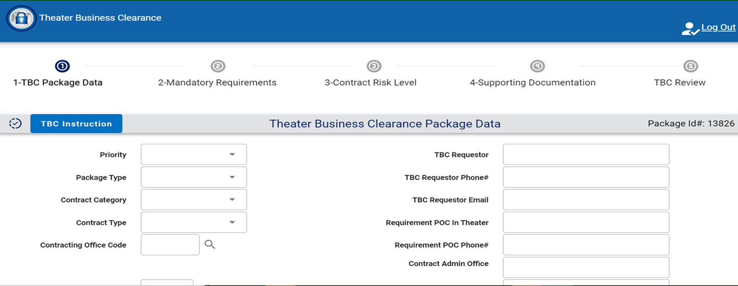
Five Basic Steps
Use the numbers at the top of the form to help navigate the five form sections.
The five sections are TBC Package Data, Mandatory Requirements, Contract Risk Level, Supporting Documentation and TBC Review.
If submitting for an AoR where a GFLSV is required, work closely with the GFLSV Requiring Activity (RA).
Upload one GFLSV per location
User-Friendly Navigation Bar Leads The User Through Each Step

Slide 7
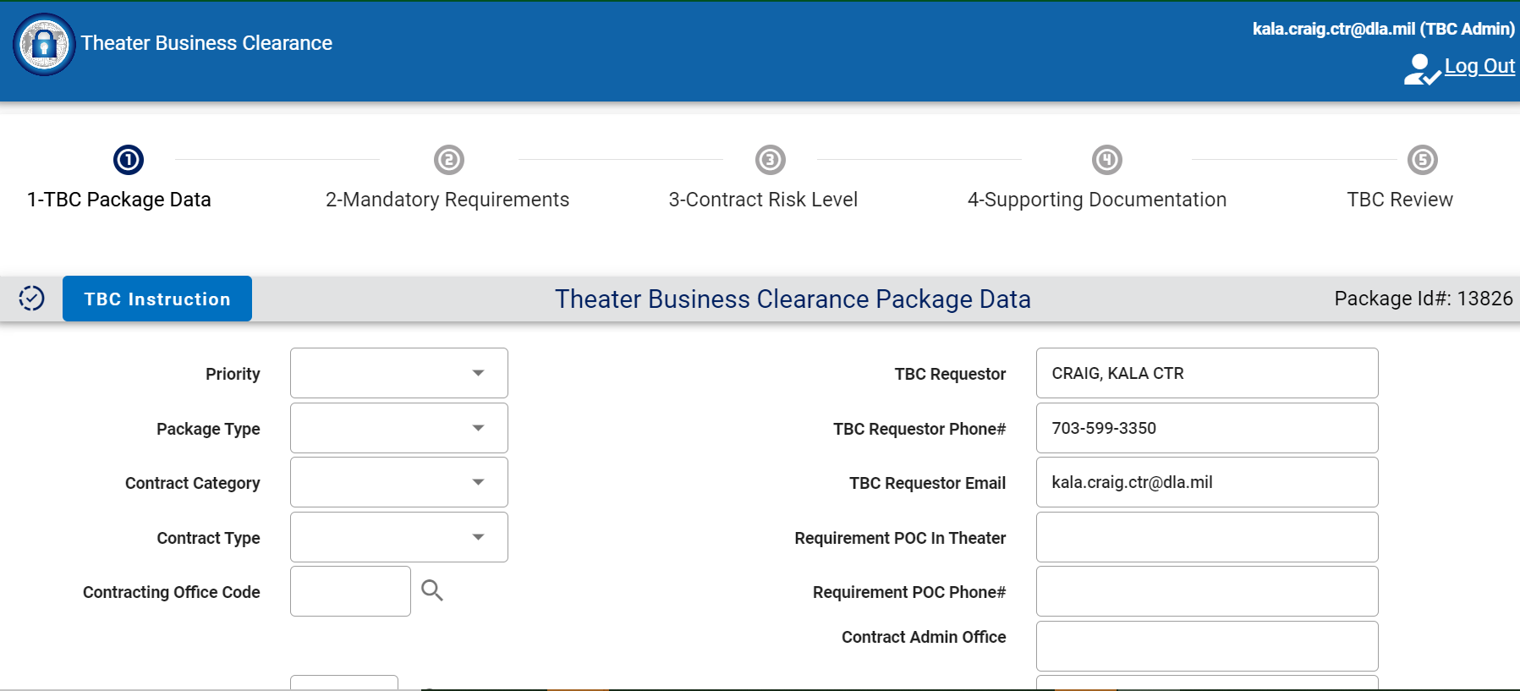
Create a TBC Package
Jane Doe
1-800-555-DLA7
555
Jane.Doe@dla.mil
This is a simple user interface to input TBC package data.

Slide 8
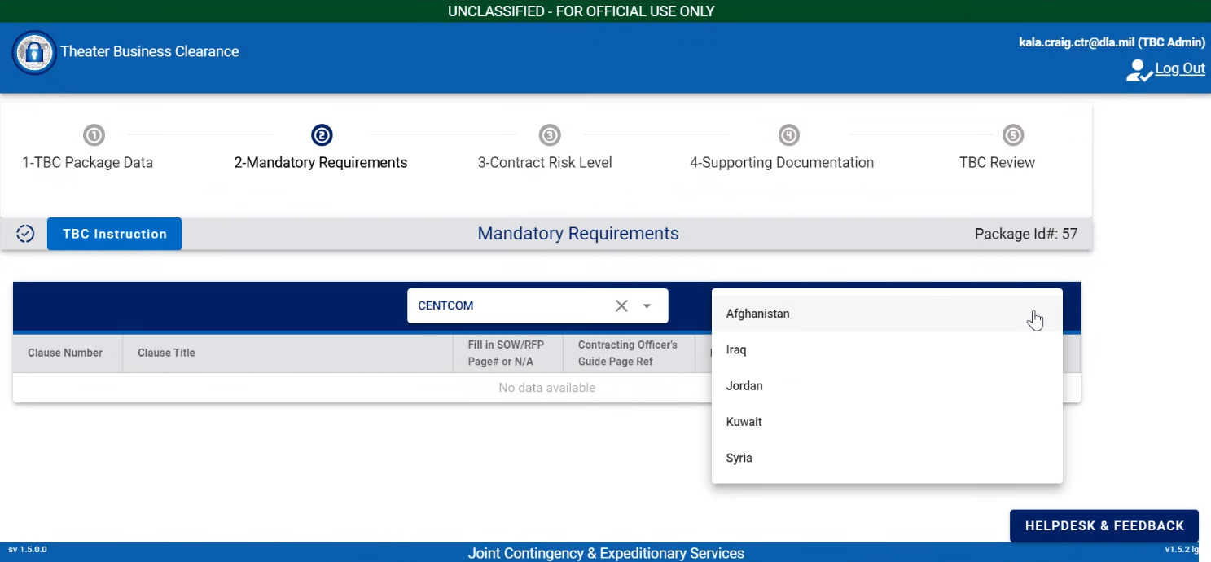
Mandatory Requirements
After selecting Cocom and location, country clauses are displayed.

Slide 9
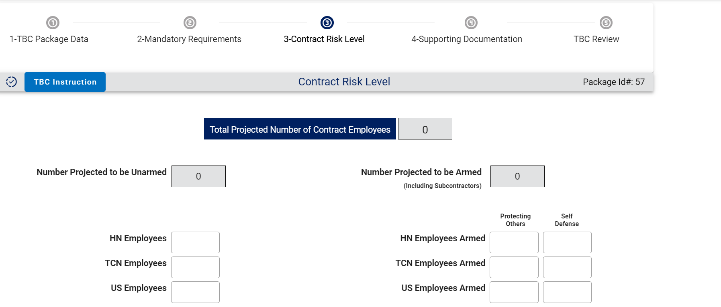
Contract Risk Level
The Total projected number of contract employees and Number projected to be armed are automatically calculated based on your input.
Enter the number of US,
HN & TCN Employees.

Slide 10
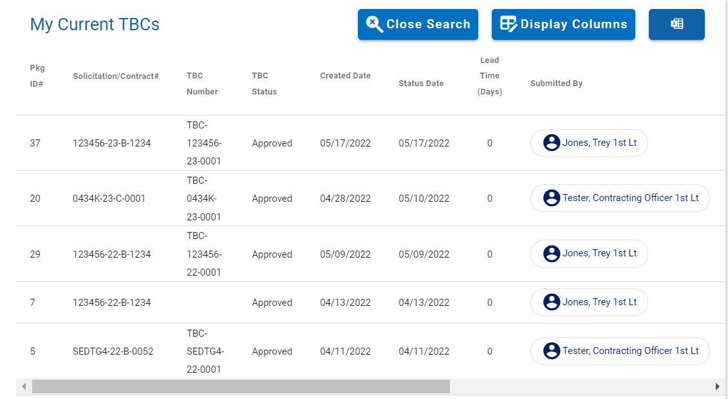
Synchronized Pre-Deployment and Operational Tracker (SPOT)
Upon approval, the TBC Number,& Pin are automatically sent to Synchronized, Pre-Deployment and Operational tracker via a web service.
.
After the TBC is approved, a contracting officer can submit for an LOA’s in SPOT for contractor deployment.

Slide 11
TBC is the Key to Success
KEY reasons why TBC is the optimal choice.
From solicitation to post award, TBC allows you to copy, transfer, and submit your TBC.
The automated workflow routes the TBC form once submitted and email notifications are sent upon approval/disapproval of TBC.
Upon Final approval, TBC number and PIIN/PIID are sent to SPOT.
Support and resources are always available.
Please utilize the Helpdesk and Feedback button, available on all pages, to submit a helpdesk ticket.
You can also access the guide in the application by clicking on resources.
TBC guides and references are accessible through the Capability Overview tab located on the JCXS website: https://www.jccs.gov

