Slide 1

Joint Contingency and Expeditionary Services (JCXS)
GFLSV User Instructions
June 2020

Slide 2
Government Furnished Life Support Validation (GFLSV)
The Government Furnished Life Support Validation (GFLSV) Application effectively records and tracks U.S. and other country contractor personnel entering into, traveling throughout, and departing from Afghanistan Area of Responsibility, that require Government Furnished Life Support (GFLS).
Role-based access to GFLSV forms and workflow is granted to Requiring Activities (RAs), Base Operating Support Integrator (BOS-I) and the Operational Contract Support Integration Cell (OCSIC). Once the RA creates the GFLSV form and submits it for approval, the form’s status is tracked until it is finalized. The dashboard format enables users to quickly find and view where the form is in the workflow and how long it has been in the system. All reviewer remarks and approval/rejection decisions with date stamps are captured in a single form.
Users must register and access the application via CAC
Key Benefits
Automates the GFLSV form submission, review, approval, and tracking processes
Records all remarks, issues, approvals, and rejections made during form processing
Form status is always visible, to include processing time, and who is currently responsible for the form
Form can be used for new requirements or a change (increase/decrease)
System Generated E-mail Notifications are forwarded to applicable roles after the Requiring Activity submits
System Generated GFLSV Approval Numbers are automatically assigned
NOTE: Access is granted to Government and Military Personnel Only!!!!
In the rare event a “contractor” is required to submit a GFLSV on behalf of the Requiring Activity (RA), the OCSIC requires approval first by their Government representative which will need to be followed by OCSIC approval. Please submit the approval request to the JCXS GFLSV Project Lead via a digitally signed e-mail.
Notes:
Draft TBC Policy, previously in progress, is on hold. Guidance per the current/approved TBC Policy is what is being adhered to.

Slide 3
Government Furnished Life Support Validation (GFLSV)
GFLSV Final approval form is REQUIRED as supporting documentation for Award/Post-Award Theater Business Clearance (TBC) Approval.
RAs please ensure your Contracting Officer has a copy of the Approved GFLSV Form required for TBC Submission/Approval
NOTE: Per Current/Approved Policy, TBC is applicable to contracts with a total value (base and all options) in excess of $150,000.00 and require contractor personnel to deploy to Afghanistan for a period greater than 30 days.

Slide 4

Government Furnished Life Support Validation (GFLSV)
Government Furnished
Life Support Validation (GFLSV)
User Registration

Slide 5
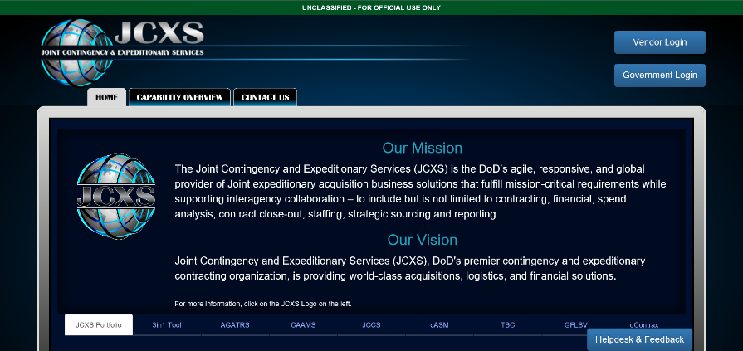
Navigating to GFLSV
The GFLSV application is a part of the Joint Contingency and Expeditionary Services Suite of Tools.
Navigate to https://www.jccs.gov/
Select Government Login.

Slide 6
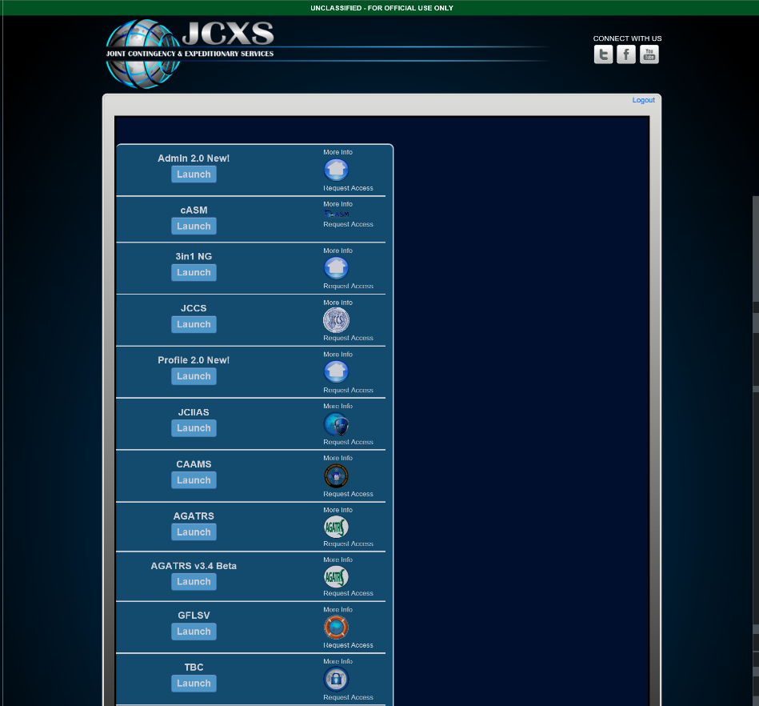


Registration
Locate GFLSV in the list of applications and select Launch.
NOTE: If you are unable to see the GFLSV LOGO in the list of applications, it means that the site has not picked up your CAC credentials. Please clear your SSL state by navigating to the following:
Browser Settings>Internet Options> Content Tab> Clear SSL State
Once your SSL State has been cleared, proceed to the JCXS application launch page again.
Notes:
If you have cleared your SSL state and are still unable to see option for GFLSV, you may need to submit a ticket with your Local IT to have https://www.jccs.gov/ added to the list of trusted sites on your network.

Slide 7
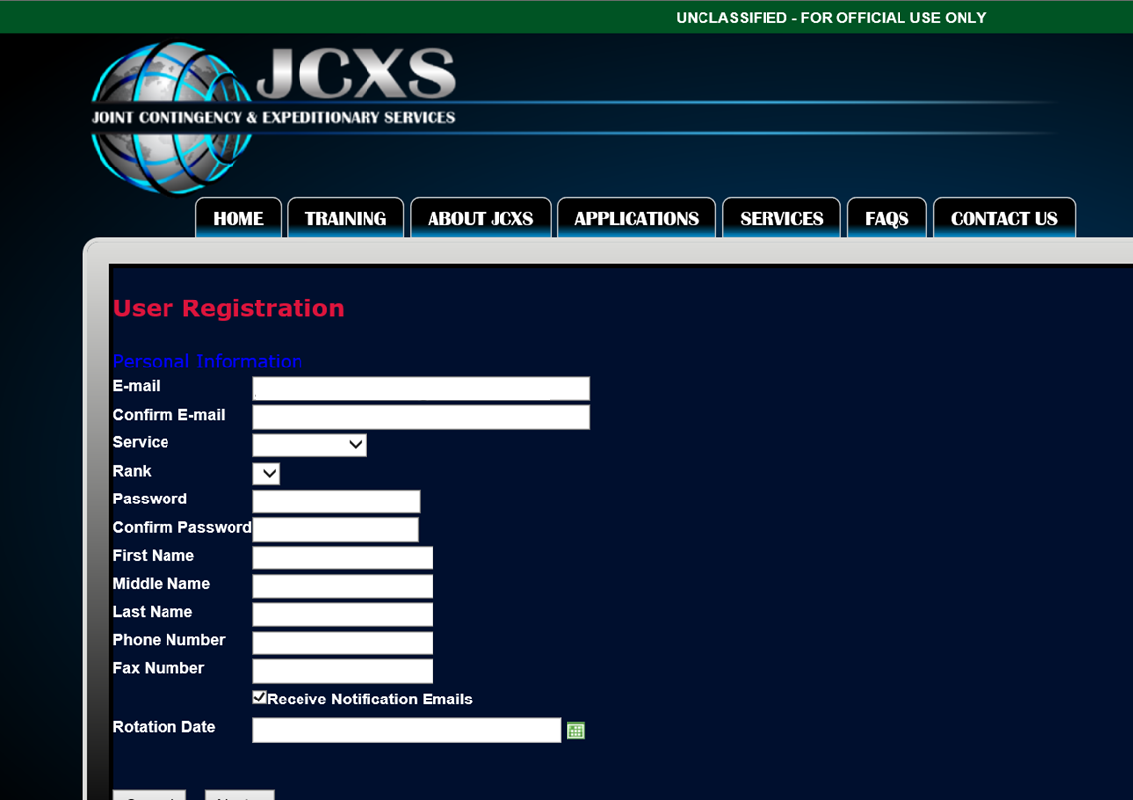
Profile Information
Complete the User Registration information.
The password that you select must be a strong DoD password.
This is a single use password for registration only.
Rotation Date (Re-deployment Date) is OPTIONAL.

Slide 8
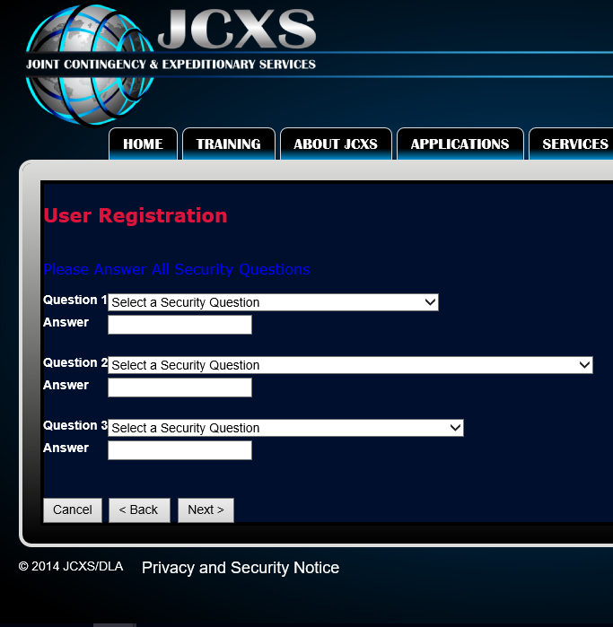
Security Questions
Select and answer your security questions.

Slide 9
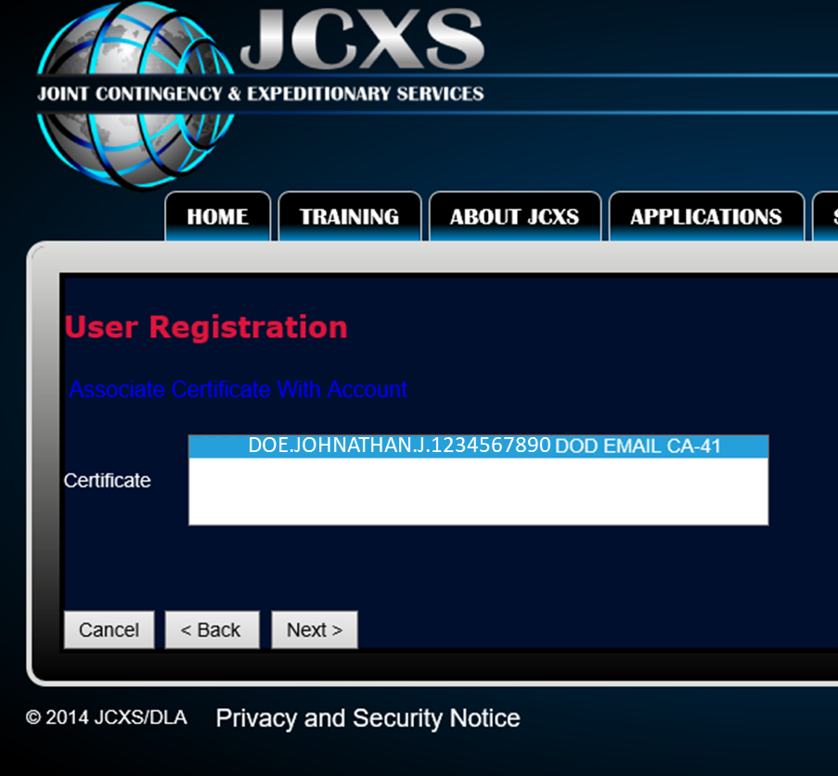
Associate Certificate
This step in the registration will associate your certificate with your account. Ensure that your CAC Credentials show and select Next.

Slide 10
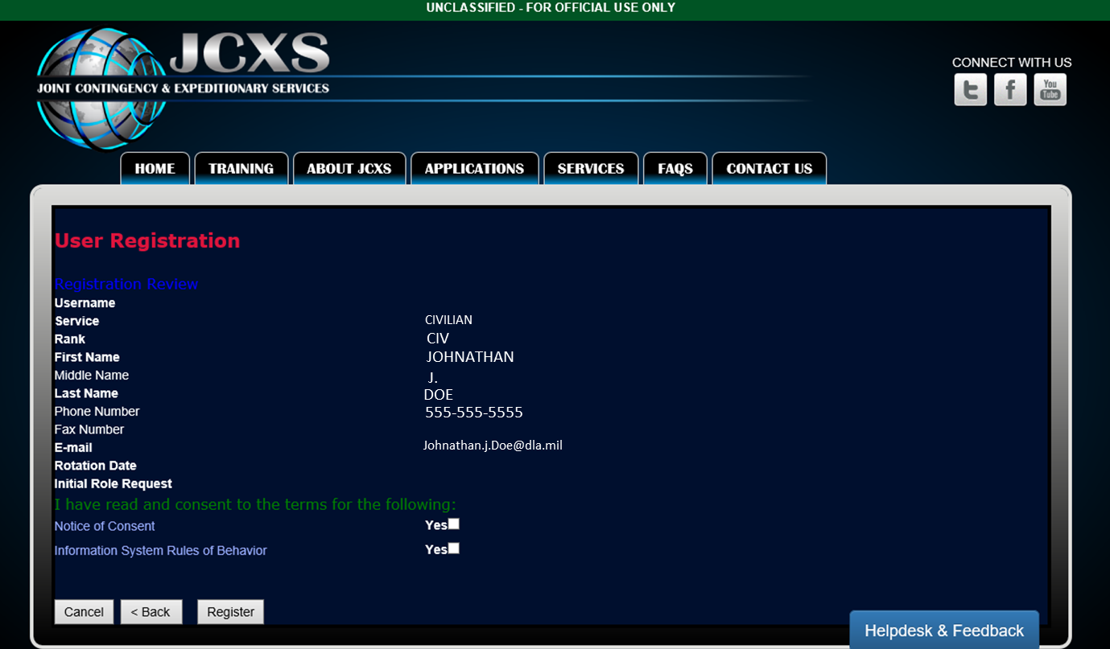
Account Review
Review and confirm that your information is correct, and agree to the terms of the site.
Select Register

Slide 11

User Roles in GFLSV
User Roles
Requiring Activity (RA)
Base Operating Support Integrator (BOS-I)
OCS - Operational Contract Support Integration Cell (OCSIC)
AKA Forward Operating Base (FOB) or Camp Mayor – a combatant commander (CCDR) designated representative who acts as the Joint BOS provider. The BOS-I coordinates the efficient use of mission support resources, provides master planning for facilities and real estate, etc.
Activity that requires the contracted services to accomplish their mission; they are either paying for or buying the service. The RA will create and submit GFSLV forms for BOS-I and OCS final approval.
Ensures synchronization of contractors with military operations, while also ensuring proper oversight of contracted effort.

Slide 12
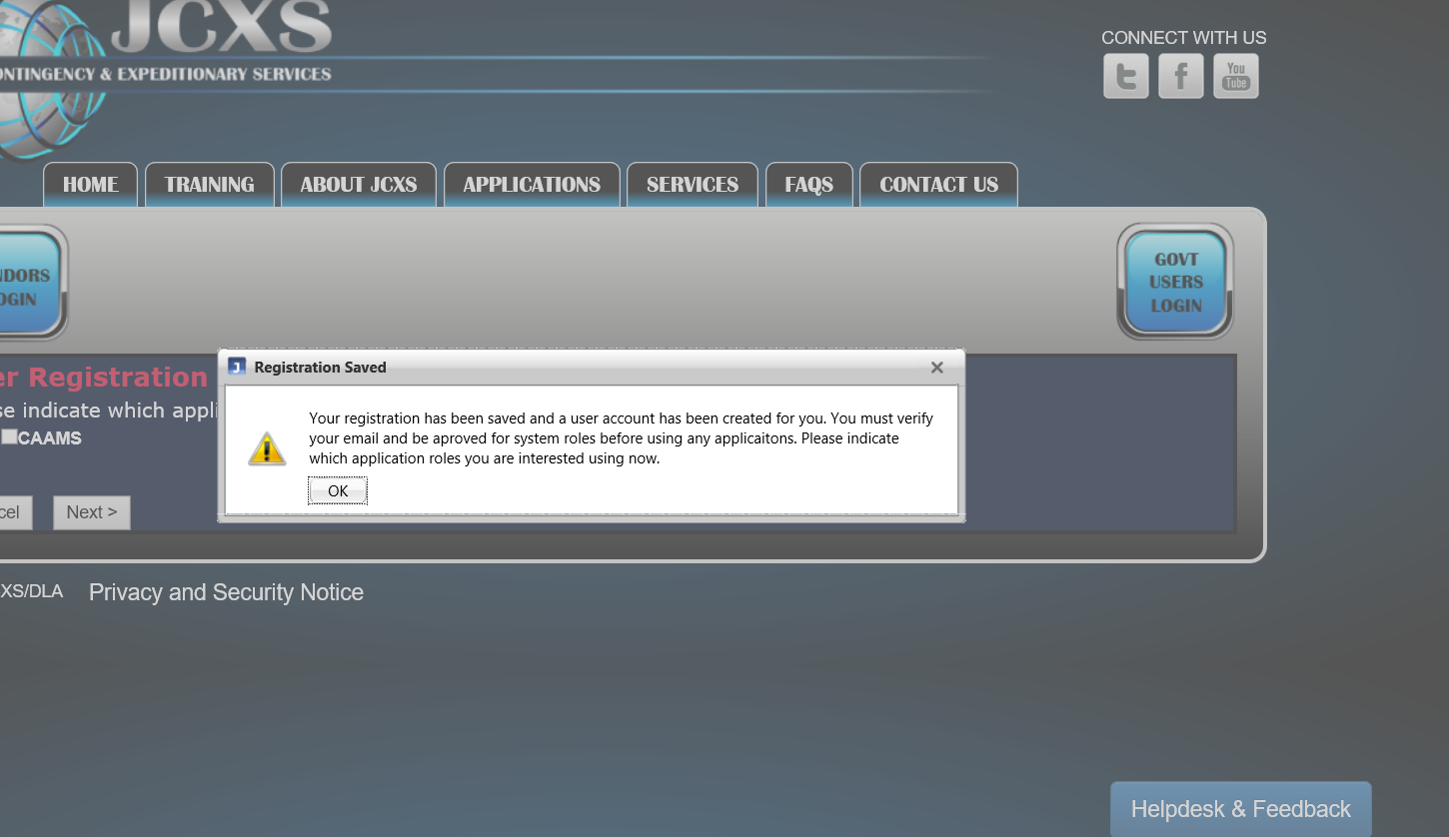
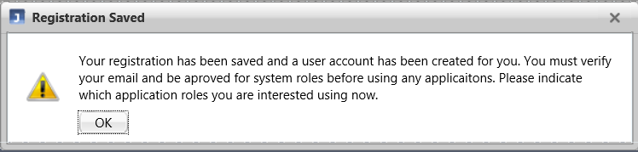
Registration Saved
Registration Saved. The first step of GFLSV registration is complete. An email will be automatically sent to your email address on file. Please look for this in order to verify your email.
Select OK to request your role.
Notes:
You can modify your role request in the “Profile 2.0” application on the JCXS application page.

Slide 13
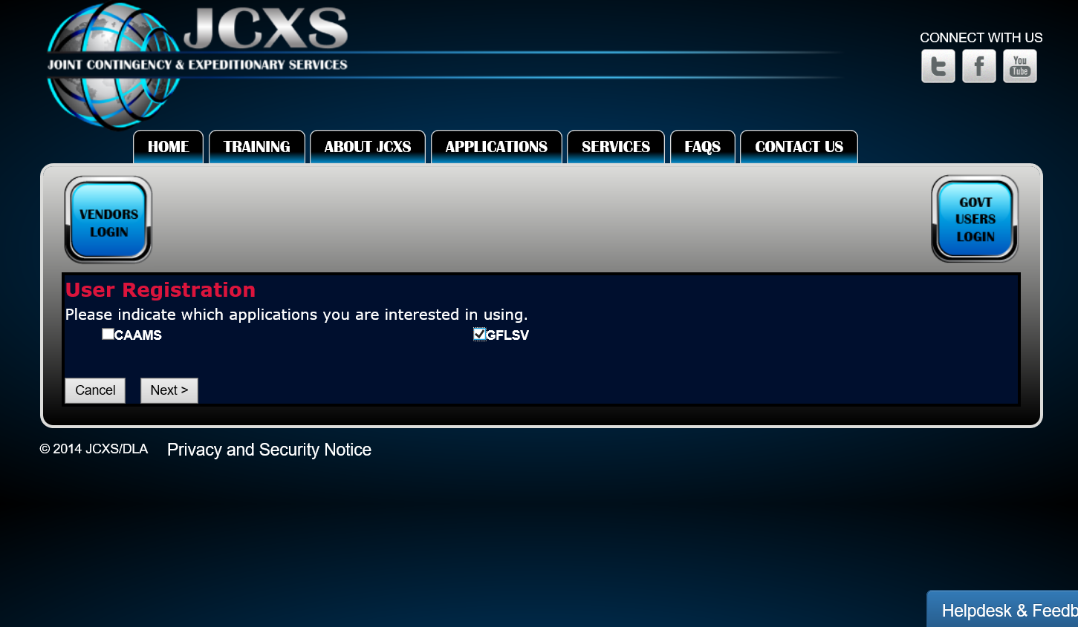
Requesting a Role
Select GFLSV
Note: Those seeking roles in both GFLSV and CAAMS will want to select both and select Next to request a role for each application.

Slide 14
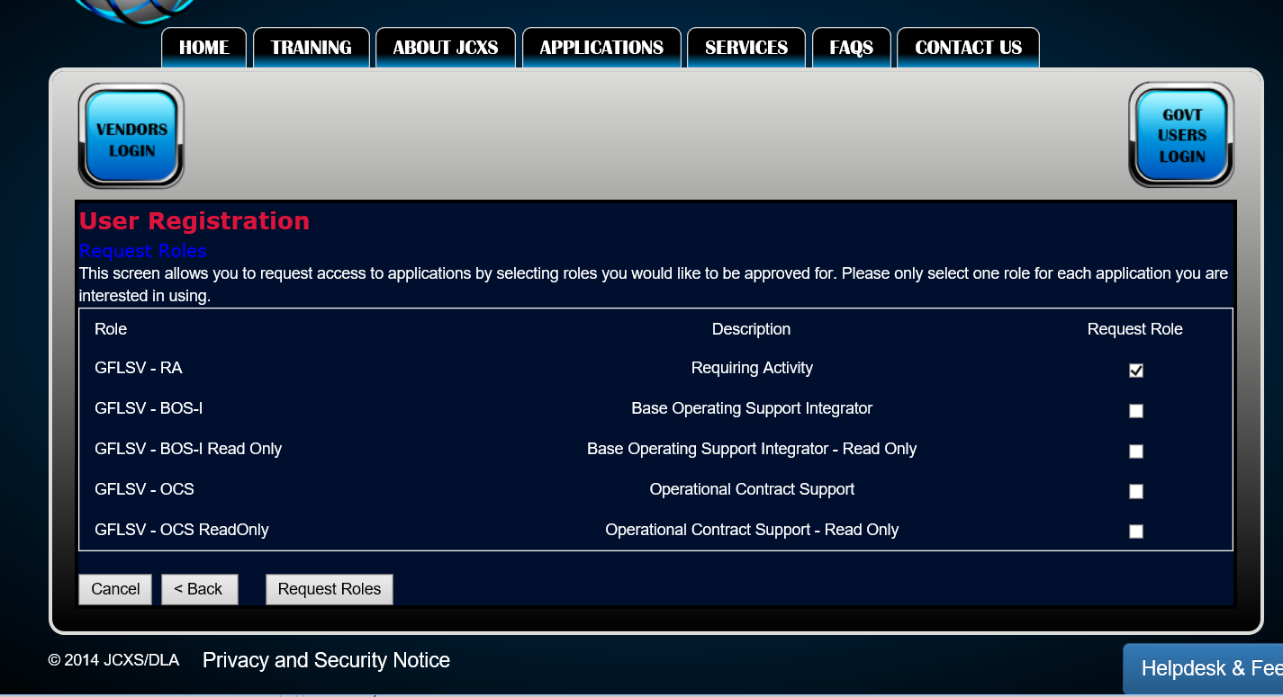
Requesting a Role
Choose from the list of User Roles available and then select Request Role.
The most common role will be the Requiring Activity. This is the role needed to create and submit a GFLSV.
Note: Each user may only have one role in GFLSV. Contact the JCXS Helpdesk for additional questions or concerns.

Slide 15
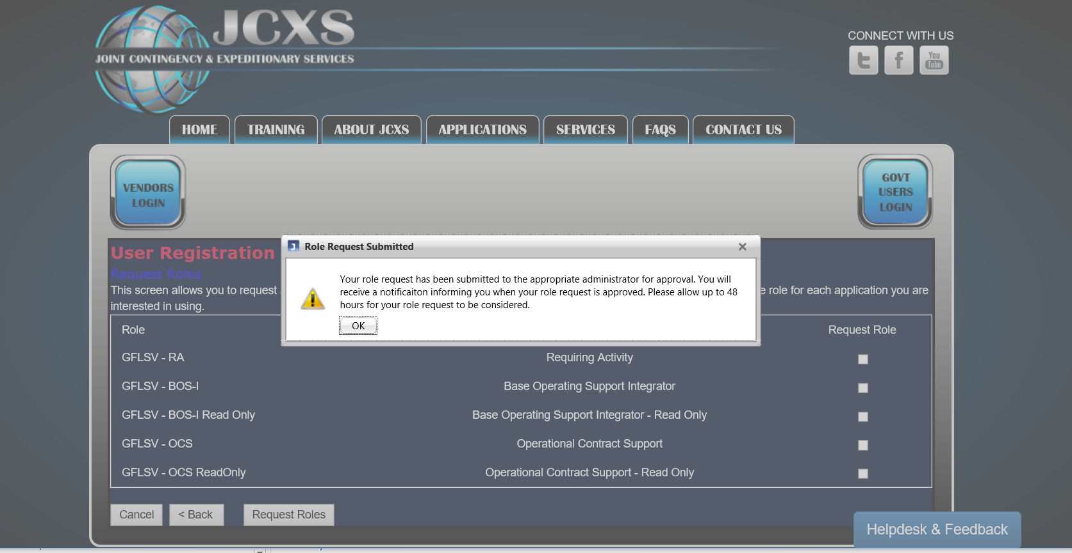
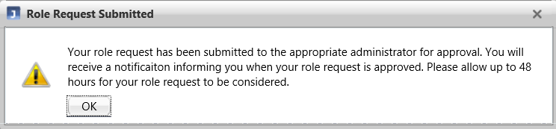
Role Request Submitted
Your request has been successfully submitted. Please take this opportunity to check your email for the email verification link. This is a required step in completing your registration.
Please allow up to 48 hours for your request to be reviewed.

Slide 16
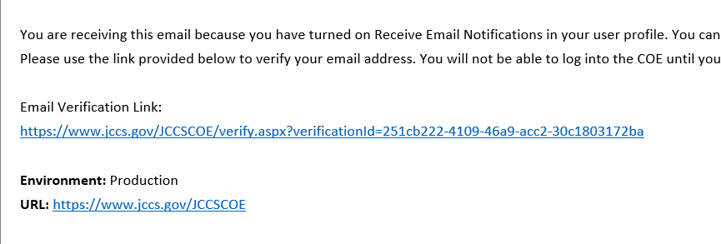
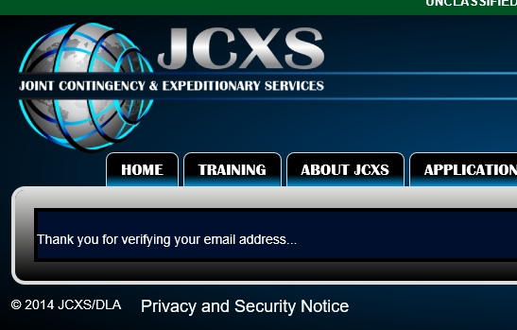
Email Verification
SAMPLE EMAIL
After registering, users will receive a link to verify their email.
This step is required in order to grant access to the GFLSV application.

Slide 17
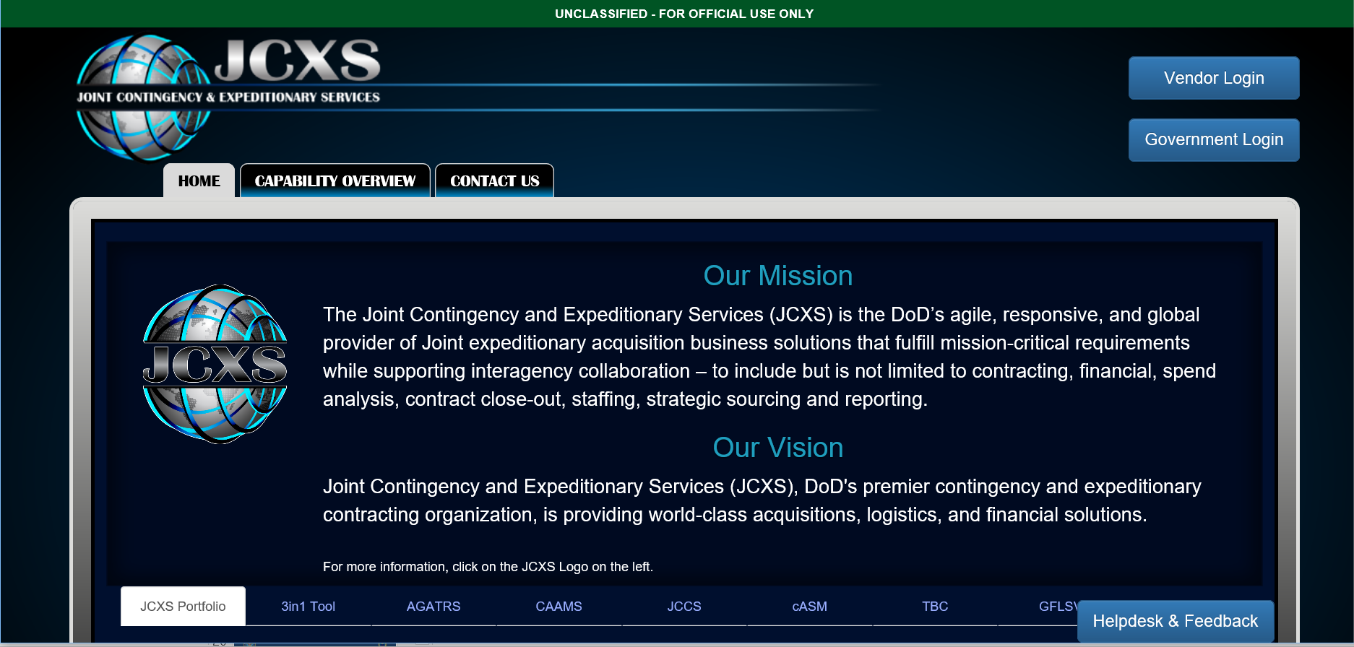
Pending Requests
You will receive email confirmation from the GFLSV team when your account has been processed.
In the event that your request is pending for more than 48hrs you may utilize the Helpdesk and Feedback button available on any JCXS site page.

Slide 18
Government Furnished Life Support Validation (GFLSV)
Government Furnished
Life Support Validation (GFLSV)
Application Guide

Slide 19
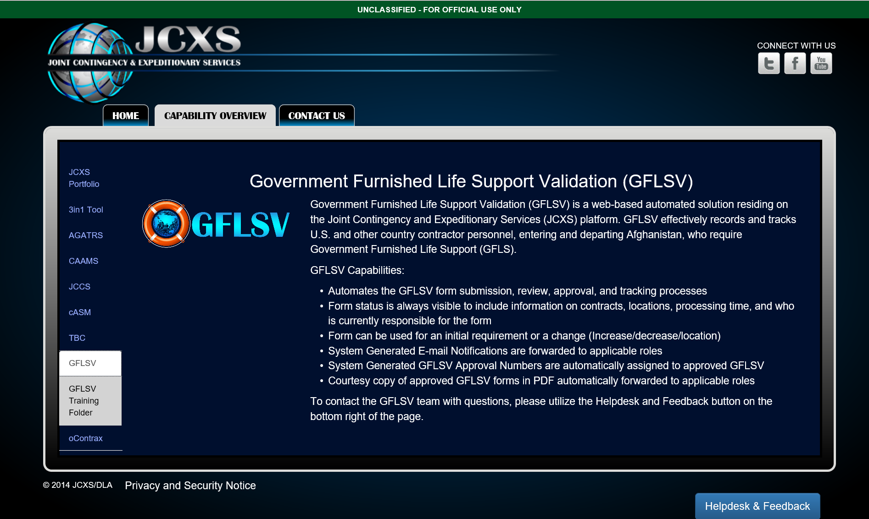
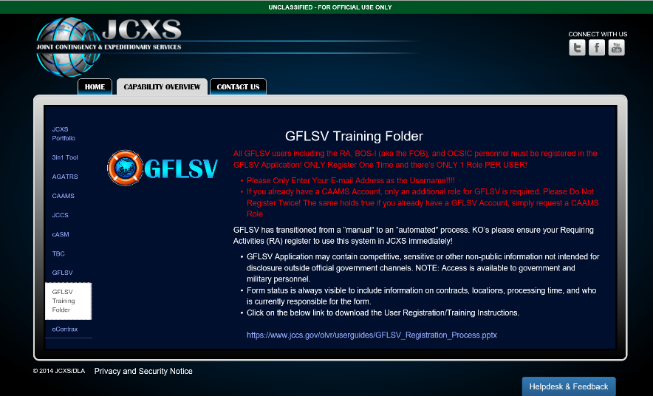
Capability Overview
A brief application overview and link to the Training Folder can be found on the Capability Overview tab of the JCXS Website.
The GFLSV Training Folder contains added details about the application as well as a link to the GFLSV Training Guide.
Notes:
Note: Training documents are updated frequently. Refer to https://www.jccs.gov/ for the most up to date version.

Slide 20
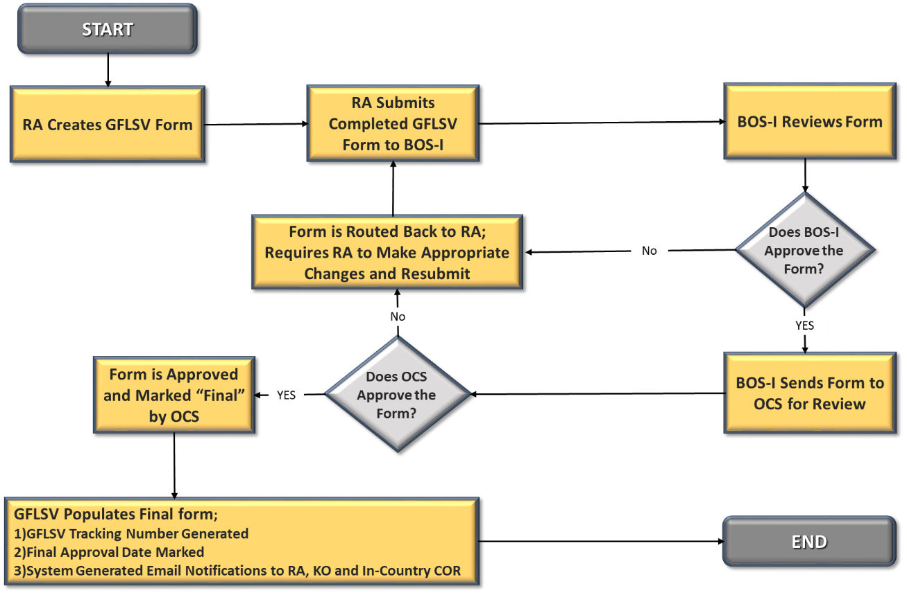
GFLSV Automation Workflow
Notes:
System Generated E-mails – Currently, an automated e-mail is forwarded to the BOS-I once the GFLSV Form is submitted by the RA. Upon approval of Final GFLSV, the application generates an additional E-mail Notification sent to the RA, KO and In-Country COR to notify them that the GFLSV has been approved.

Slide 21
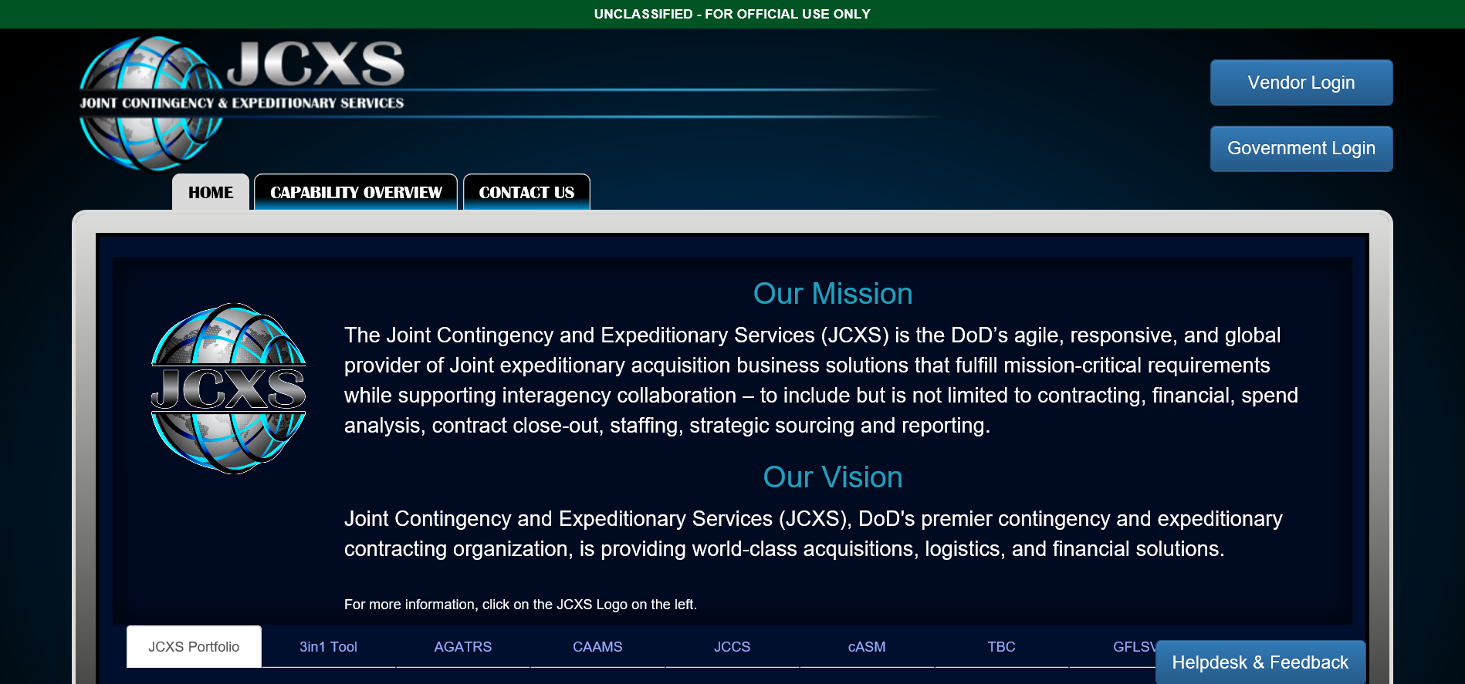
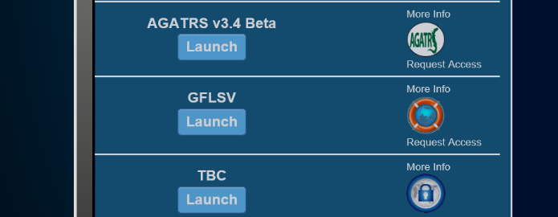
Getting Started with GFLSV
After successfully registering and receiving confirmation from the JCXS GFLSV Team, you will be ready to access the application.
Navigate to https://www.jccs.gov,
Select Government Login.
Locate GFLSV in the list of JCXS applications, and Select Launch.
Notes:
GFLSV form is required prior to Award and Post-Award TBC Approval.
NOTE: Per Current/Approved Policy, TBC is applicable to contracts with a total value (base and all options) in excess of $150,000.00 and require contractor personnel to deploy to Afghanistan for a period greater than 30 days.

Slide 22
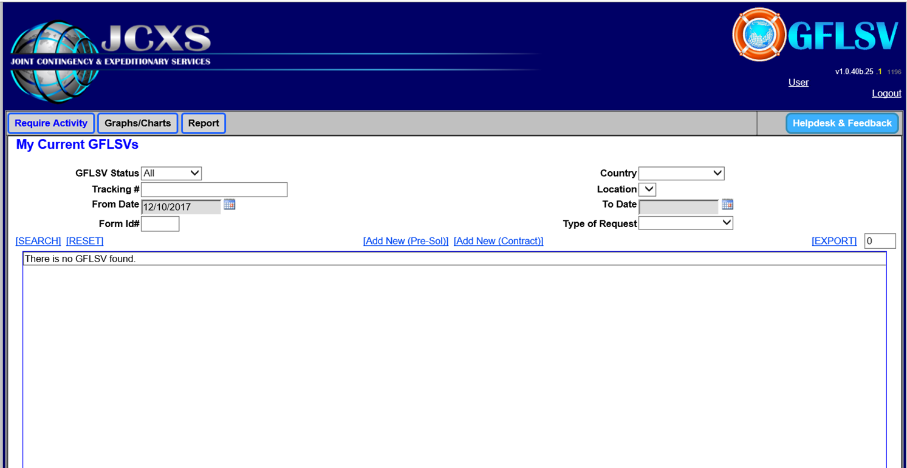
Welcome to the GFLSV Dashboard
The Requiring Activity (RA) will only see the GFLSVs that they have created.
To create a new GFLSV, the RA will select one of the two options:
Add New Pre Solicitation
Add New Contract ( E.g., DoD Contracts, GSA & HHS)
All RAs should work closely with their KO/Contracting Office to ensure they obtain the information needed to complete the GFLSV in its entirety.
Notes:
In most instances, users will select “Add New Contract” If unsure of which option to select, please contact your Contracting Office.

Slide 23
Welcome to the GFLSV Dashboard
Only select “Add New Pre-Sol” after consulting with your KO/Contracting Office and with a clear understanding that you are in the preliminary phase of the contract. If you are in the preliminary phase of your contract and do not have a contract number, chances are you need to select the Pre-Sol option. Again, work with your KO/Contracting Office. Selecting the incorrect option will delay overall GFLSV processing.
Notes:
All RAs should work closely with their KO/Contracting Office to ensure they obtain the information needed to complete the GFLSV in its entirety.

Slide 24
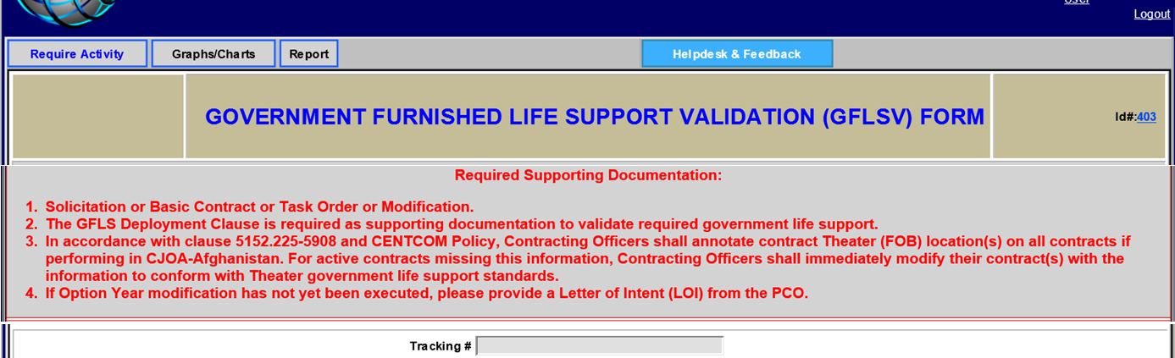
The GFLSV Form
Review the list of Required Supporting Documentation outlined at the top of the GFLSV for reference. You will want to reference this later when adding your attachments to the form.
Notes:
Please ensure you read the text carefully. It details the Required Supporting Documentation, subject to change, which you will need to include when submitting your GFLSV Package.

Slide 25
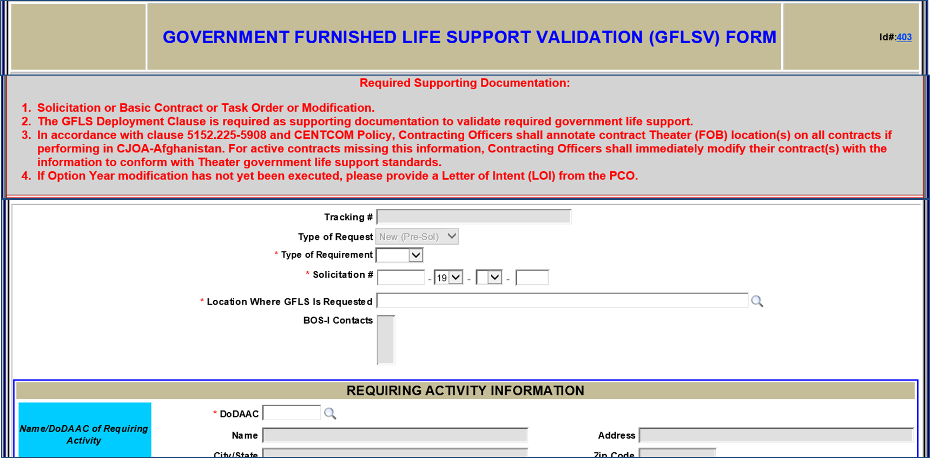
The GFLSV Form
Solicitation #
Verify that you are entering the correct solicitation number.
Type of Requirement
Use the dropdown to select the type of requirement.
The drop-down contains options for the Instrument Type. Available choices for Pre-solicitation are B,Q,R,T. If the number you enter contains a letter not listed, please return to the dashboard and select “New Contract”. Consult with your KO/Contracting office often.
Notes:
The Type of Requirement (formerly “Name of Service”) list has been modified to display the following options: Construction, Research & Development, Services, Supply & Systems.

Slide 26
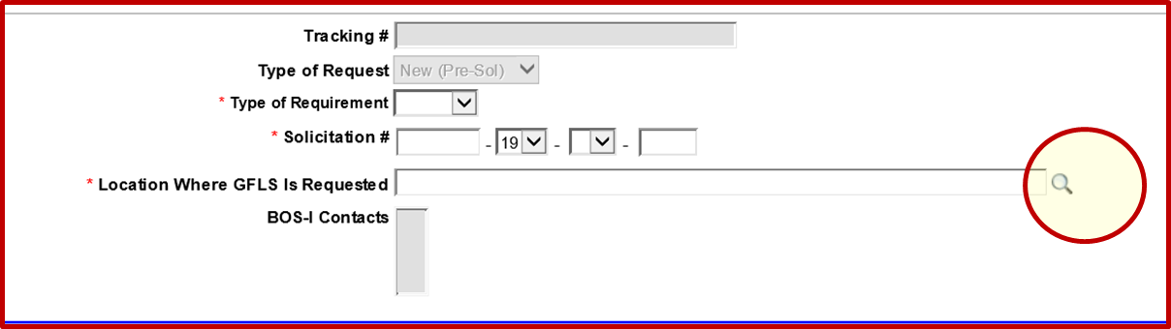
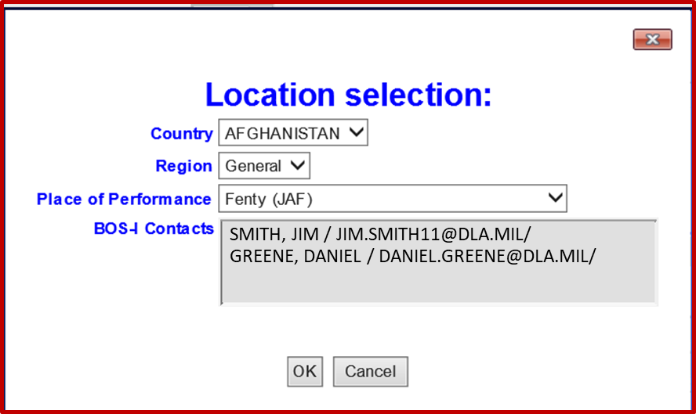
The GFLSV Form
Select the magnifying glass to choose the location.
A Pop-up window will appear to help filter on location.
BOS-I contacts will display based on place of performance. When you select OK these contacts will auto-populate on the form.
Notes:
NOTE: IF the designated/applicable BOS-I is not listed, it’s possible he/she has not Registered in JCXS and must do so.
IF the BOS-I redeploys and JCXS is not notified, then the package sits in the queue until the database is updated. If your package remains in the queue for sometime after submitting, contact the OCSIC for an update.

Slide 27
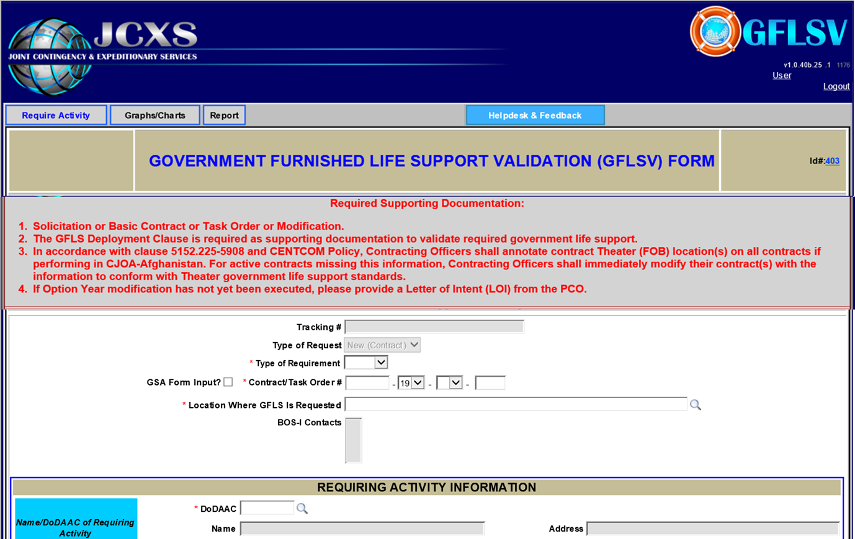

DoD Contracts
For DoD Contracts
Enter the Contract/Task Order Number.
If you have a Task Order Number you will enter it here.
Example
Task Order Number: W911RU-19-F-0019 Base IDIQ Number: W911RU-19-D-0001

Slide 28

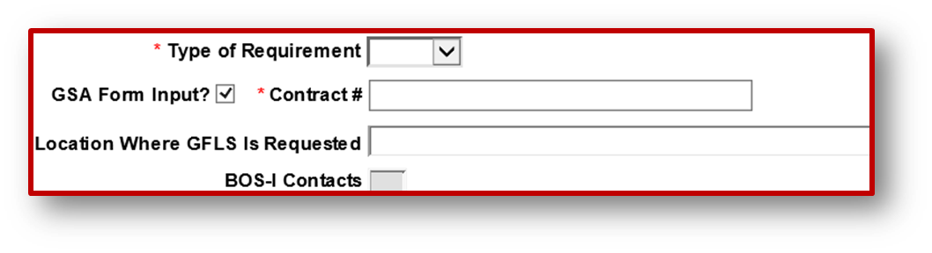
GSA & HHS Contracts
For GSA and HHS Contracts
Select the GSA Form Input box. This yields a “free-form” text field to accommodate your Contract Number.

Slide 29
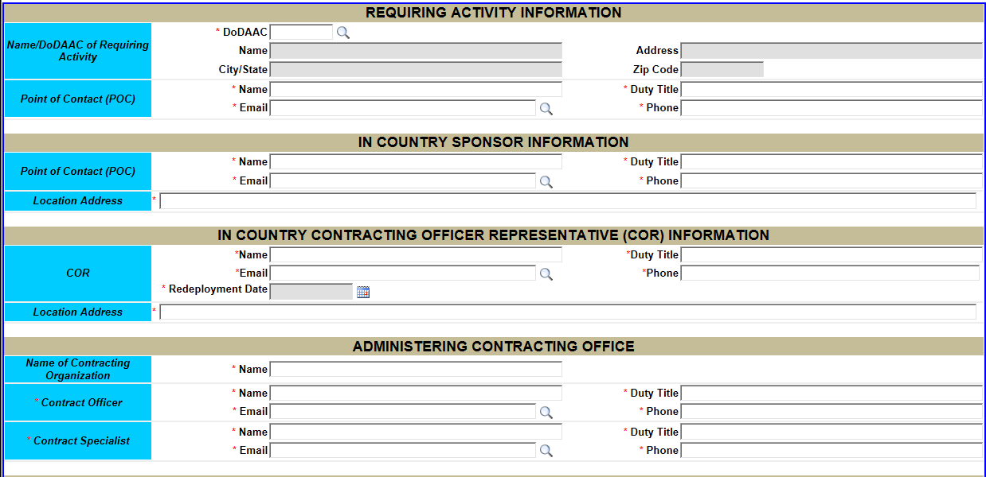
GFLSV Form Details
Enter the DoDAAC, and Select Search
If the search feature does not yield a corresponding DoDAAC, key the DoDAAC in the field and continue completing your form.
Enter the POC email
If you have entered the POC into the system at least once and saved, their name and contact information should populate once you select search.
ONLY use the Calendar to populate the Redeployment Date. Do Not Type in the Date Field.
Ensure you populate All Mandatory Fields (marked with a Red Asterisk).
Notes:
If the DoDAAC Search returns void, this does not preclude you from continuing on with your GFLSV Package. Simply type in your DoDAAC and continue with your form. At your convenience, submit a HelpDesk+ Ticket requesting the DoDAAC be added.

Slide 30
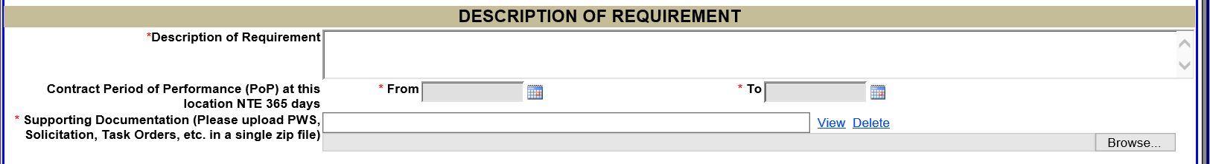
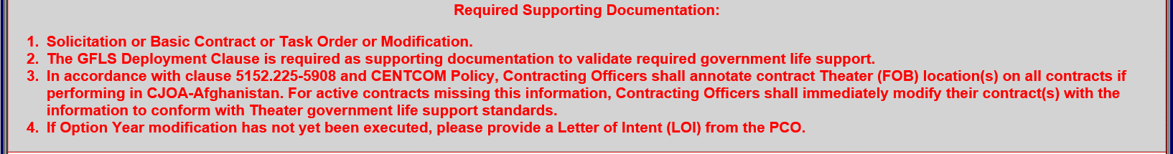
Description of Requirement
Provide a description of your requirement.
Utilize the Calendar to enter your Period of Performance (PoP).
Note the PoP is not to exceed 365 days.

Slide 31
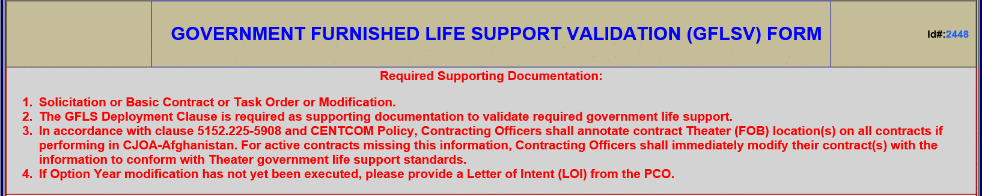
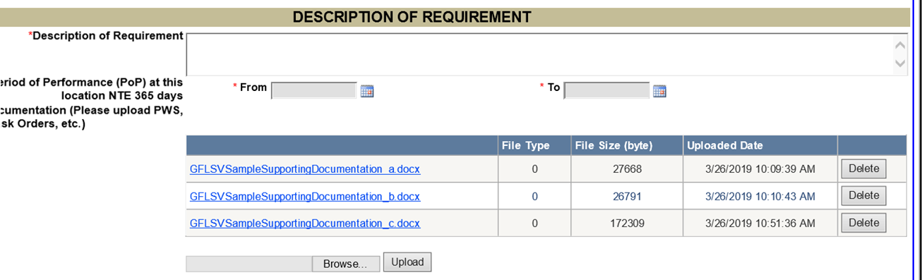
Upload Required Supporting Documentation
The text at the top of the form details the Required Supporting Documentation for GFLSV. Read it carefully & ensure your supporting documentation includes Special Clause 5152.225-5908. Non-compliance results in a Disapproval from the OCSIC and delays overall GFLSV processing.
Upload Required Supporting Documentation
Select “Browse”
Navigate to desired file on your computer (Supporting documentation can be uploaded individually or zipped into a single file)
Select “Open”
When the file name displays, select “Upload”
Notes:
Please ensure you read the text carefully. It details the Required Supporting Documentation you need to include when submitting your GFLSV Package.

Slide 32
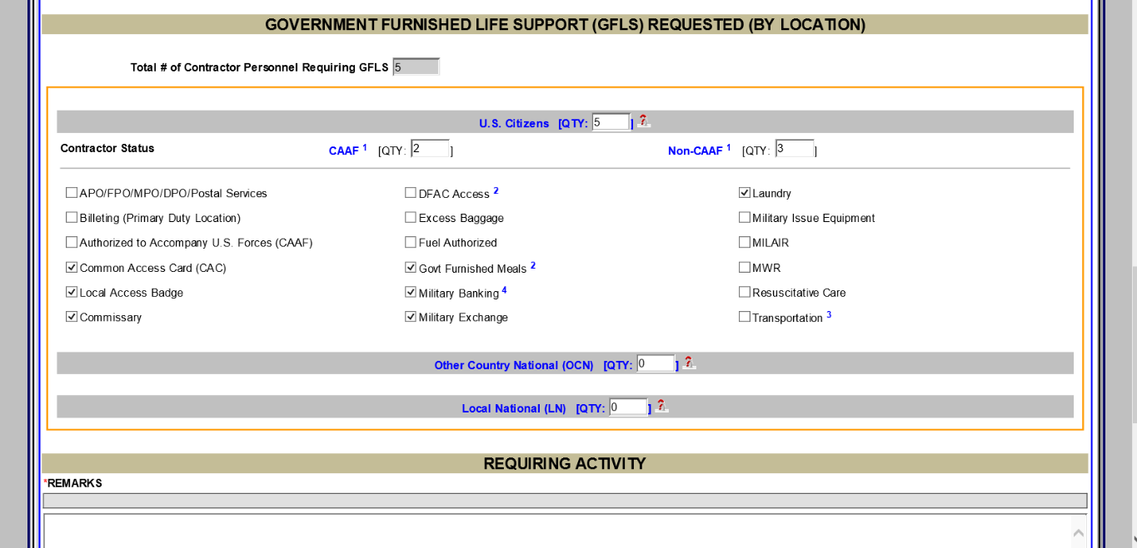
RA Creates GFLSV Form
When you reach the GFLS Requested (By Location) fields, you will enter the total number for each classification of people. This will expand the form for additional details.
Specify the number of CAAF and Non-CAAF.
Check the Applicable Life Support Services.
Repeat this process for the next two categories (if applicable).

Slide 33
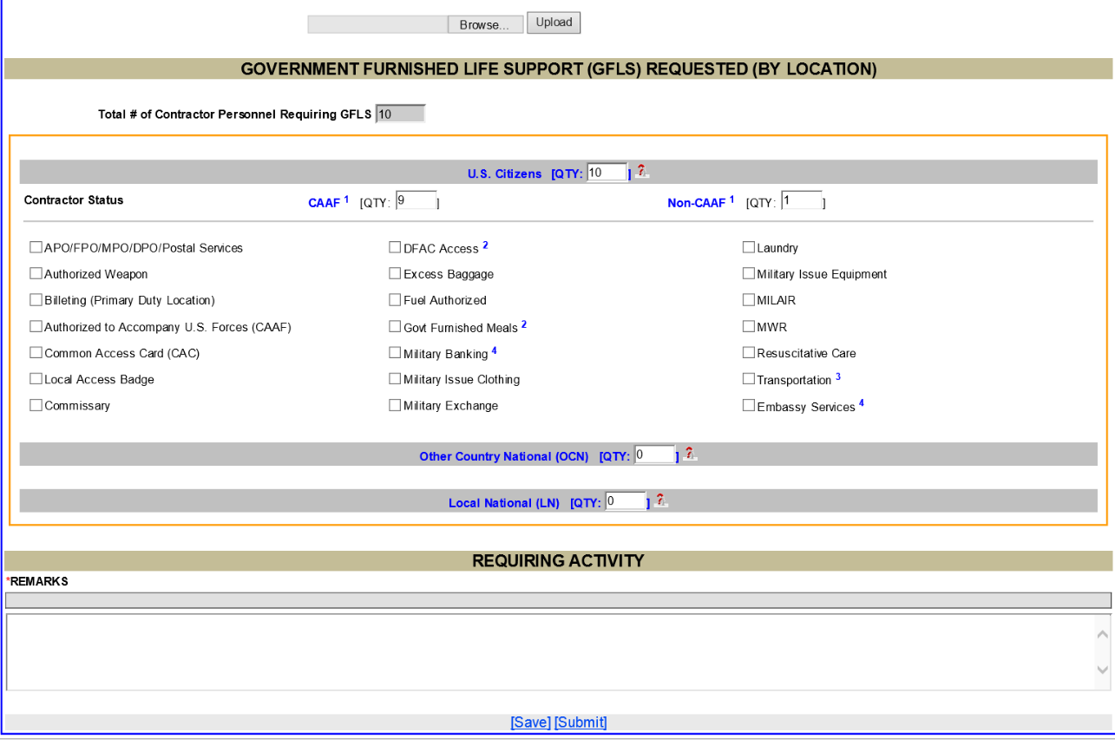
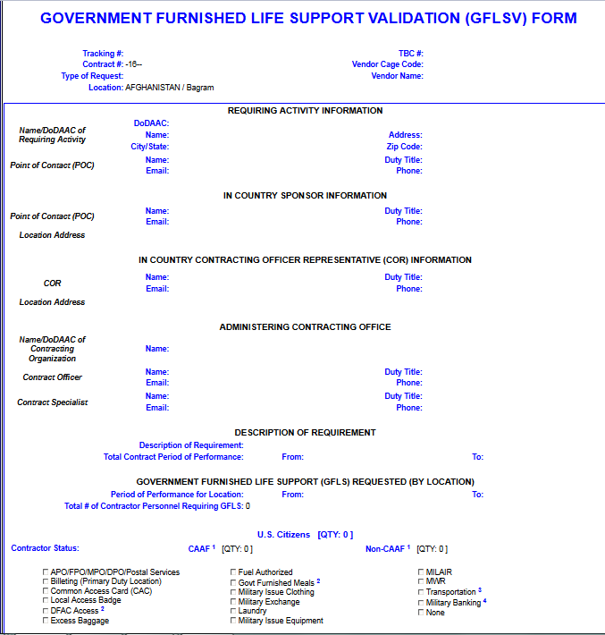
GFLSV Automated Form Overview
“RA” creates GFLSV form, completing “ALL” Mandatory Fields.
SAVE Often! System times out after 20 minutes.
Utilize the Calendar Icon when entering dates.
Key in the DoDAAC then Search.
Don’t use the BACK Button! Return to your dashboard by clicking on the applicable RA, BOS-I or OCS Tab at the top of your page.
Upon completion of the automated GFLSV form, the RA should Save, review and then select Submit.
NOTE: If there are fields omitted on the form, the fields will turn red and the form will not submit.
Once submitted, an email notification is automatically routed notifying the BOS-I that there is a GFLSV to review and approve.
Please allow 15 Days for final approval.

Slide 34
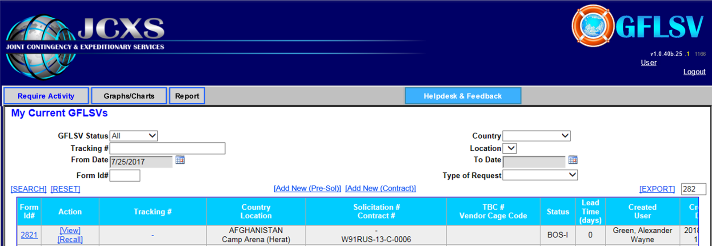
Managing your Submitted GFLSV
Track the status of your package as it moves from RA to BOS-I to OCS to FINAL.
NOTE: Should a submitted package return to the status of RA, please review, make the requested changes and resubmit.
RA
BOS-I
OCS
FINAL
Select Recall to make changes to a submitted package.
If there is a need to generate a PDF for review prior to submitting your form, select the dash within the Tracking Number column for a PDF of your form.
Notes:
In order to recall a GFLSV at the status of OCS, the RA will need to submit a helpdesk ticket and include the reason for the recall.

Slide 35
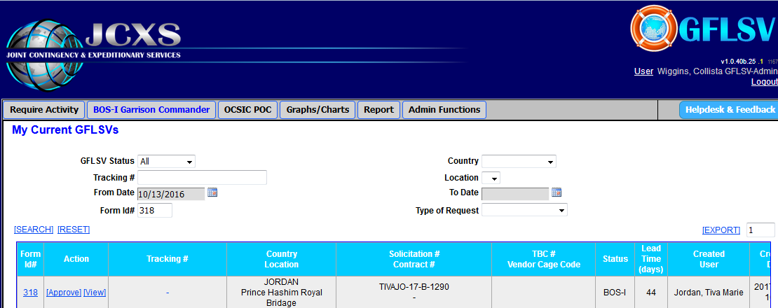
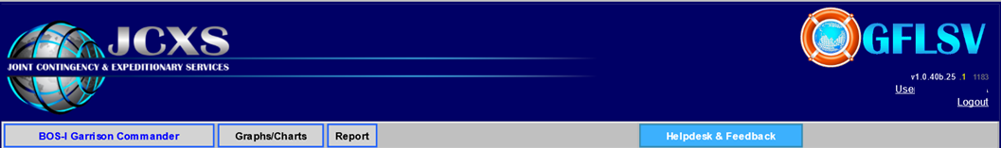
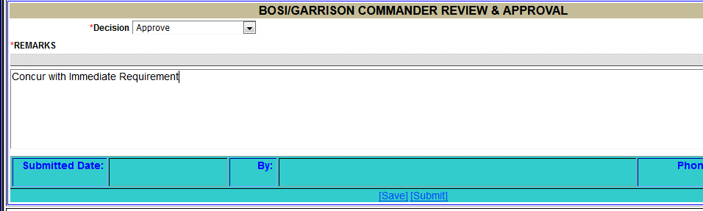
BOS-I Review
Select Approve on your dashboard to open and review a GFLSV submitted by an RA.
BOS-I/Garrison Commander Review
While in the form, Select the dropdown on the Decision field. Select either “Approve” or “Disapprove –Return to RA”.
Enter Remarks (Required).
Select Save and then Submit
Note: If Approved, the form is automatically routed to the OCSIC for Review/Final Approval. If Disapproved, the form is returned to the RA to correct and re-submit to the BOS-I.

Slide 36
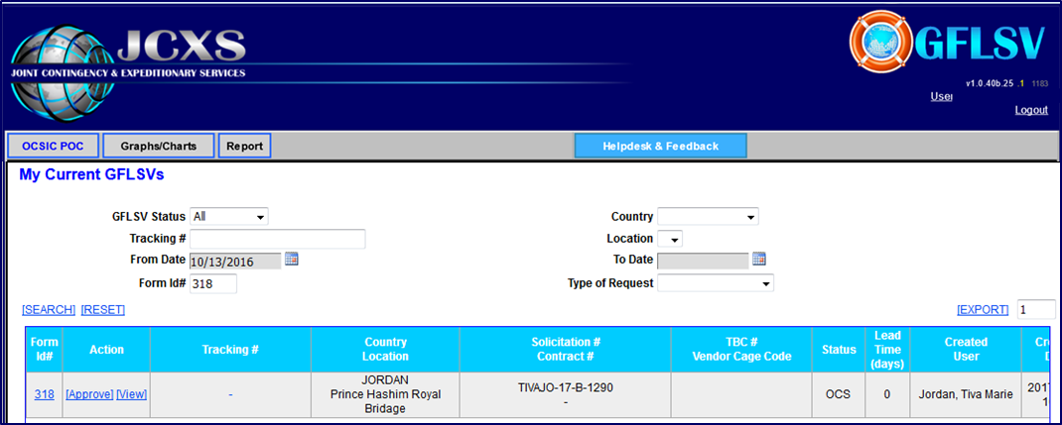
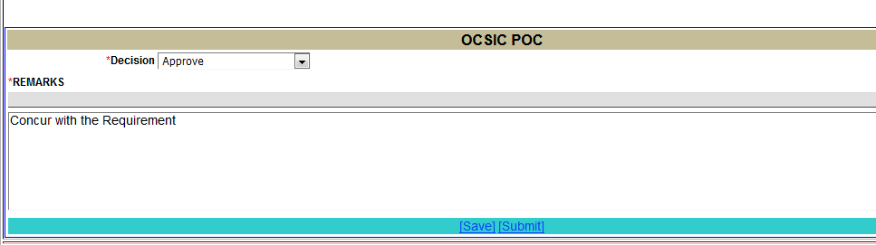
OCS View
Select Approve on your dashboard to open and review a GFLSV submitted by a BOS-I.
OCSIC Review
Within the form, select the dropdown on the Decision field. Either select “Approve” or “Disapprove –Return to RA”.
Enter Remarks (Required).
Select Save and then Submit
Note: If Approved, the form yields a Tracking/Approval Number and an email notification will be sent to the RA, KO and In-Country COR. If Disapproved, the form is returned to the RA for correction and re-submission. Please allow 15 days for approval.

Slide 37
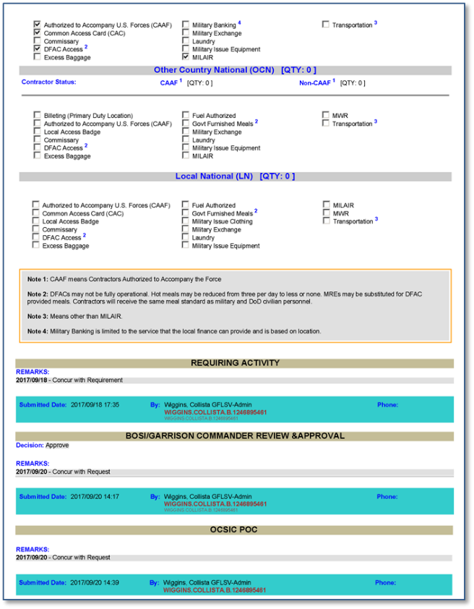
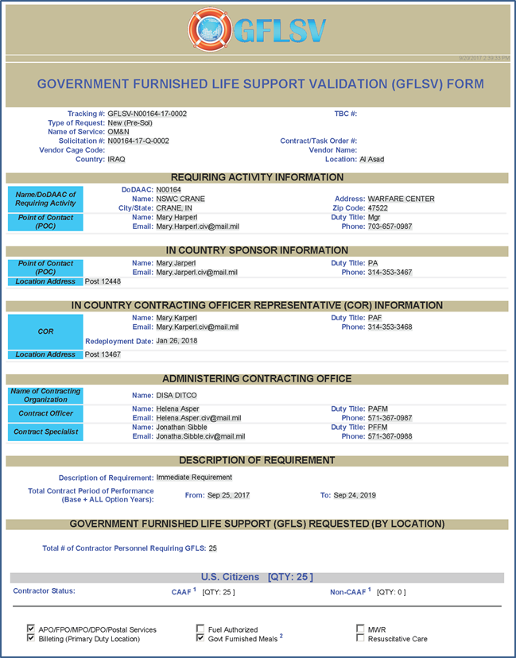
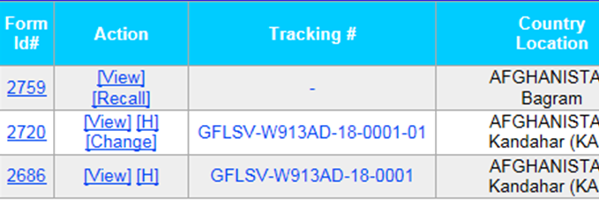
Final GFLSV Form
Saving your Final GFLSV form as a PDF:
A system-generated Tracking Number is assigned to each GFLSV after final approval.
REMINDER
A PDF copy of the Final GFLSV is required as supporting documentation for submitting a Theater Business Clearance (TBC). Please ensure your Contracting Officer has a copy of the FINAL approved GFLSV.
From the dashboard, select the Tracking Number to generate a PDF.

Slide 38
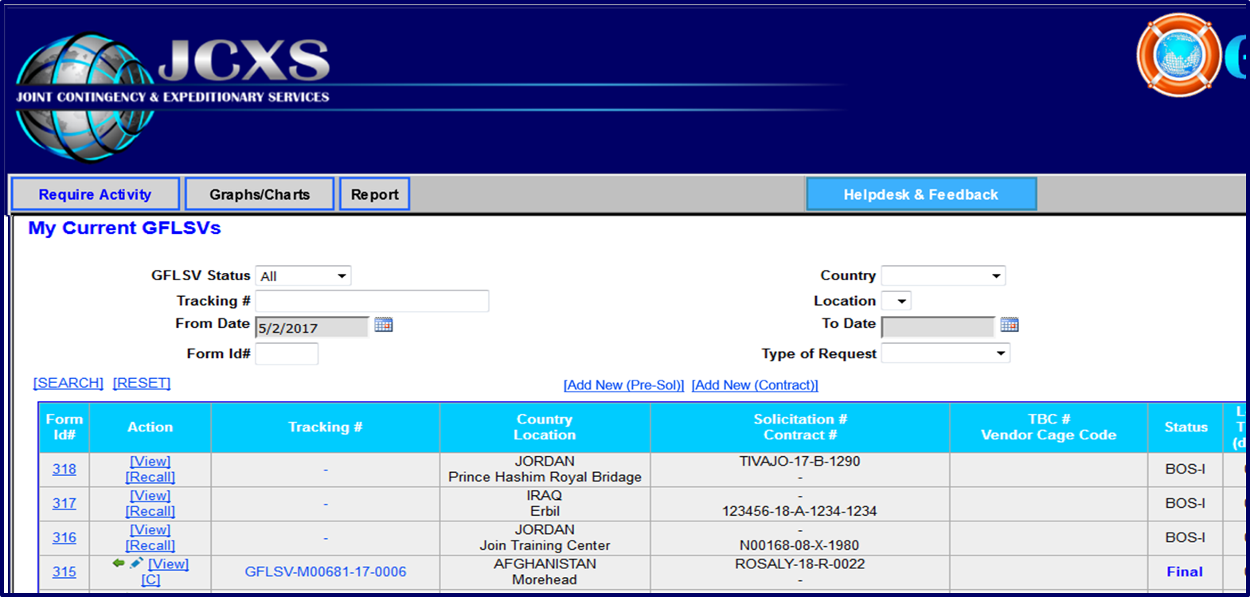

Modifying a Final Pre-Sol to Reflect an Award
GFLSV allows the RA to modify a Final Pre-Solicitation to reflect an Award.
Select the Pencil Icon.

Slide 39
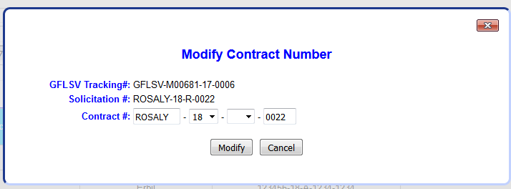

RA Modifies Final Pre-Sol to Reflect Pre-Award
The only modification allowed for this type of request is to change the Contract Number
Adjust this entry to reflect the actual Contract Number
Select “Modify”
Example of how a modified package would display

Slide 40
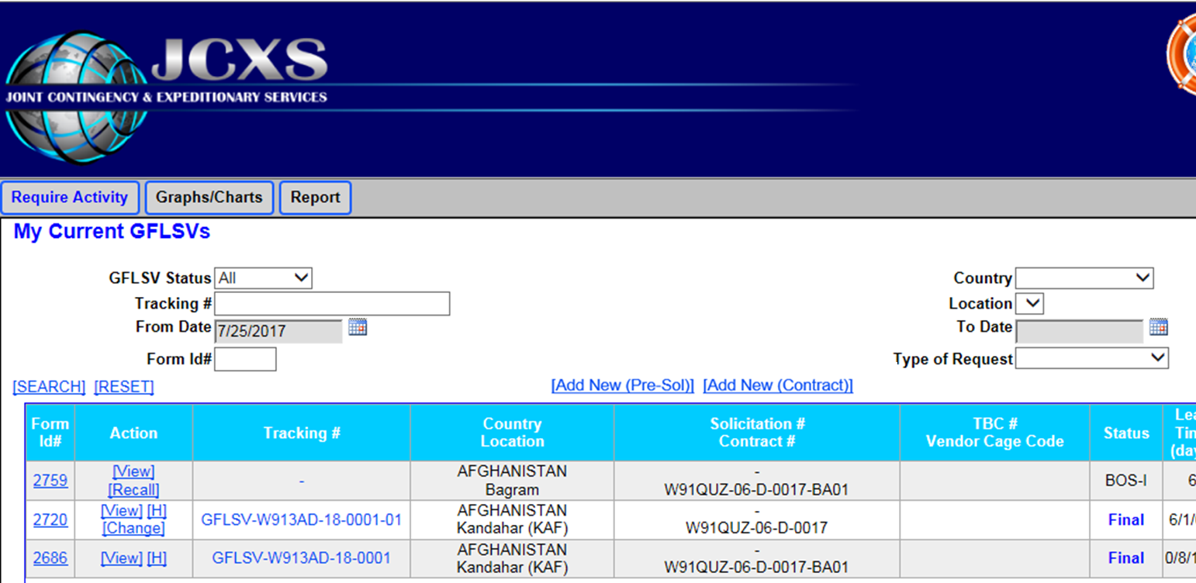
Increase or Decrease in Personnel
Increase/Decrease in Personnel and a change in Life Support can be performed by selecting “Change” on packages that are already approved.
Notes:
Per the TBC policy(page 4), modifications that increase or decrease the number of contractor personnel performing in Afghanistan, that add or delete authorized GFLS items, or change locations of contractor personnel will require a revised GFLSV form and approval from the BOS-I / Garrison Commander and the USFOR-A Operational
Contract Support Drawdown Cell (OCSDC) Team.

Slide 41

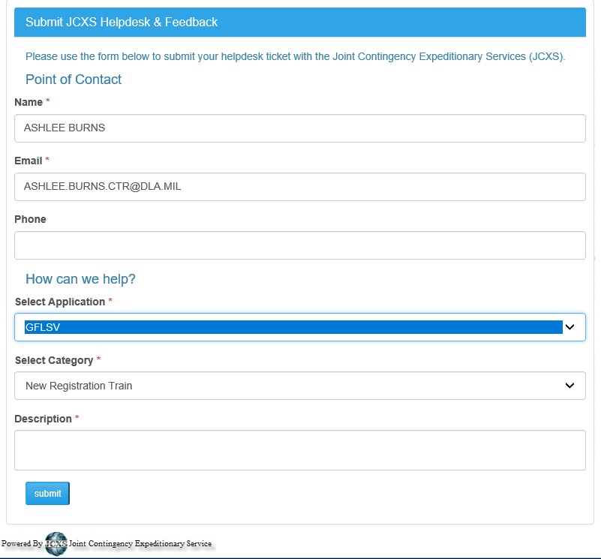
Need Help?
To contact the JCXS/GFLSV CONUS Help Desk:
Click Helpdesk & Feedback on any screen, select “GFLSV”, then fill out the ticket.
Submit your ticket and a Help Desk specialist will contact you.

Slide 42
Points of Contact
OCSIC Data Manager
DSN Phone: 318/481-9918
EMAIL: centcom.bagram.usfor-a-ocs.mbx.portfolio-manager@mail.mil
JCXS GFLSV Lead
Robert Perdue
EMAIL: Robert.Perdue.ctr@dla.mil
JCXS GFLSV Deputy
Kala Craig
EMAIL: kala.craig.ctr@dla.mil
JCXS Program Oversight Lead
Nina Summers
EMAIL: Nina.Summers@dla.mil

Slide 43


Slide 44
GFLSV Quick Tips and FAQs
Registration and Access
Users must access the GFLSV Application via CAC
All GFLSV users including RAs, BOS-Is, and OCSIC personnel must be registered. Only 1 Role per individual.
GFLSV Privileges are granted to Government & Military Personnel Only. In the rare case a contractor needs to submit a GFLSV Package on behalf of the Requiring Activity (RA), the OCSIC requests an approval first by a Government representative followed by OCSIC approval. Please submit the approval request to the JCXS GFLSV Project Lead via a digitally signed e-mail.
If you are not seeing the GFLSV logo in the list of applications it is likely due to the fact that your CAC credentials are not being pulled upon entering the https://www.jccs.gov/ site. Please clear your SSL State (Browser Settings>Internet Options> Content Tab> Clear SSL State). If you have cleared your SSL state and are still unable to see the option for GFLSV, you may need to submit a ticket with your Local IT to have https://www.jccs.gov/ added to the list of trusted sites on your network.

Slide 45
GFLSV Quick Tips and FAQs
Registration and Access
Quick Steps for Registration
  Navigate to https://www.jccs.gov/
  Select Government Login
  Locate GFLSV on the list and select “Launch”
  Complete registration information
  Request a role
  After registering on the site, you will receive an email with a link to verify your email address. This is important. Please ensure that you select the email verification link.
  Registering on https://www.jccs.gov/ completes the first step of registration. Your account request will need to be reviewed; completing this step alone will not instantly grant access into the application.
If you are experiencing issues accessing the TBC and GFLSV applications through the JCXS homepage please try these direct links
  TBC - https://www.jccs.gov/OLVRCAC/bta_jccs_login.aspx
  GFLSV - https://www.jccs.gov/JCCSCOE/LaunchPage.aspx?Id=88cfb352-0e96-40c1-a83e-7c78e062df51

Slide 46
GFLSV Quick Tips and FAQs
Working within the Application
“RA” creates GFLSV form, completing “ALL” Mandatory Fields.
SAVE Often! System times out after 20 minutes.
Users completing the GFLSV forms should work closely with their Contracting Officer / Contracting Office to obtain the information needed to complete the GFLSV in its entirety.
The “Add New Contract” link generates a form to be used for DoD Contracts, GSA &, HHS. Add New Contract should also be selected for a new Period of Performance. Only select “Add New Pre-Sol” after consulting with your KO/Contracting Office and with a clear understanding that you are in the preliminary phase of the contract.
Utilize the Calendar Icon when entering dates.
On the form, key in the DoDAAC then Search. If the DoDAAC Search returns void, this does not preclude you from continuing on with your GFLSV Package. Simply type in your DoDAAC and continue with your form. At your convenience, submit a JCXS HelpDesk+ Ticket requesting the DoDAAC be added.

Slide 47
GFLSV Quick Tips and FAQs
Working within the Application
Required Documentation– The red writing at the top of each GFLSV form gives details of the Required Supporting Documentation you must include when submitting your GFLSV Package.
While in the application, do not use the browser BACK Button. Use the buttons on your dashboard to navigate through the application. When in the form, Save and then select the button at the top of the page that displays your role (RA, BOS-I, OCS). This will return you back to your dashboard.
To generate a PDF of your Final GFLSV, navigate to your dashboard and select the Tracking Number associated with your approved GFLSV. If a GFLSV has not reached the approval status of “Final”, the Tracking Number column will display a dash. In the event that a user chooses to seek guidance, or desires review prior to submitting their form, selecting this dash will also generate a PDF.
Inquiries regarding the status of “submitted” GFLSV forms should be submitted through the JCXS Helpdesk and are forwarded to the GFLSV OCSIC PM.
For all application and user support issues, utilize the JCXS/GFLSV CONUS Helpdesk and Feedback button available on any page of the JCXS website. Select “GFLSV”, then fill out the ticket. Please allow up to 48hrs for a GFLSV Team member to review and respond.

