Slide 1

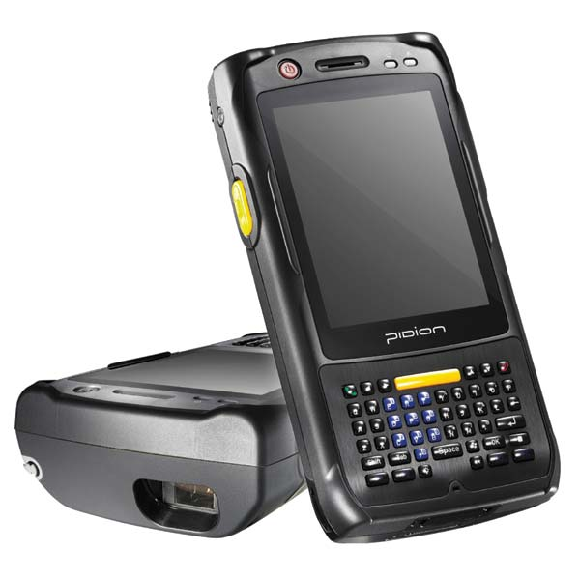
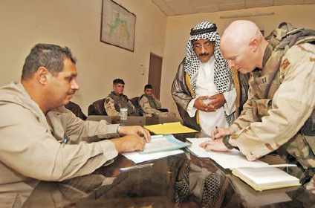
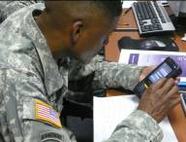



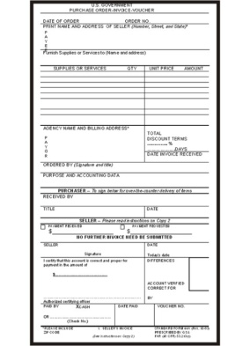
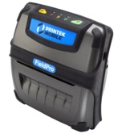
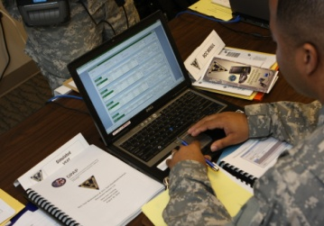

Improvements
Automating a 50-year-old paper process
Improves audit-ability, accountability and visibility of SF44 transactions in the field
Eliminates illegible paperwork, deciphering handwriting, lost receipts
Provides immediate visibility of transactions and payments
Improves data and purchase control
Eliminates travel for clearing when cash replenishment isn’t required
Eliminates excessive document reproduction, storage, or shipping
Eliminates redundant data entry
Enables analysis of orders & expenditures
Improves cash management and tracking
Permits daily reconciliation without face to face meetings
Provides audit trail of all transactions in AOR
Reduces unmatched disbursements from SF 44 purchases
Eliminates duplication of payment risk
Reduces time and work for procurement, accounting, reconciliation
The 3in1 Tool automates three key stages of the Standard Form 44 Process: Ordering, Receiving, and Payment. It combines them into one simple solution, which is used to purchase supplies and services in contingency environments by a Field Ordering Officer (FOO) and Paying Agent (PA) team. The 3in1 Tool records and transmits cash-and-carry purchases and payment data when conducting on-the-spot, cash purchases where GPC usage is not feasible. The 3in1 Tool is a joint procurement and financial solution developed to reduce risk to the field team, improve procurement/cash management on the battlefield, and provide immediate visibility into purchases/payments.
The 3in1 Tool is comprised of three key components: a ruggedized handheld device with portable printer, a website application, and a prime database/server. The handheld device is used in the field to input, temporarily store, and then transmit purchase and payment information. The website facilitates core pre- and post-order system functionality, such as: management of handheld devices and role-based system access; storage, reporting, and analyzation of purchase and payment data; and transmission of payment/contract information to other financial/document storage systems like Electronic Data Access (EDA). The prime database/server is a specialized module within the Joint Contingency & Expeditionary Services (JCXS) program, an existing series of systems used to manage and post contracts and track contractors housed at DISA DECC; it acts as the link between the handheld device and website, allowing for the flow of information between 3in1 Tool components.
From this…
For additional information
Email 3in1support@dla.mil
or visit our website at
https://www.jccs.gov/jccscoe/
…to this!
Bluebird Pidion BIP 6000- Small (3.1"x 6.3" x 1.4"), light-weight (14.3oz with battery), ruggedized to MIL-STD-810F, 2Gig FIPS 140-2 compliant memory, 3.5" Touch Screen, 3.7V, 4400mAh, Li-ion rechargeable battery, 3 megapixel autofocus camera with LED flash, WiFi, GSM, USB and Ethernet connectivity.
Automating the SF44 Process from End-to-End
Version 3.6
Manual Process
Hand-write SF44
Type SF44 data into PIIN Log
Make 5 Copies of all documents
Travel to PBO, DA, KO, RM to Clear
DA enter SF44 in DDS
DA updates manual PR ledger
DA scans SF44 for archive
Hardcopy shipped to CONUS
KO maintains file
FOO maintains file
PA maintains file
DA maintains file
Problems
Illegibility of SF44/Receipt
Errors: Calculation of order, ledger totals, or exchange rate
Documents lost or damaged
Wasted time
  Duplicate data entry
  Excessive Paper Reproduction
  Traveling to Clear
Lack of oversight/visibility of purchases & cash control from delayed clearing
Unnecessary Risk due to travel
Unmatched documents requiring manual tracking
No Theater-wide visibility
Printek FieldPro Mobile- Small (6.1" x 5.9" x 2.7"), light-weight (20 oz with battery) ruggedized portable printer used to print an SF-44 on site if required.
3in1 Tool leverages the existing JCXS infrastructure. JCXS Tools are currently in use in contingencies for vendor registration, contract solicitation, and contract management and tracking at some locations. Servers are housed at DISA with COOP backup.

Slide 2
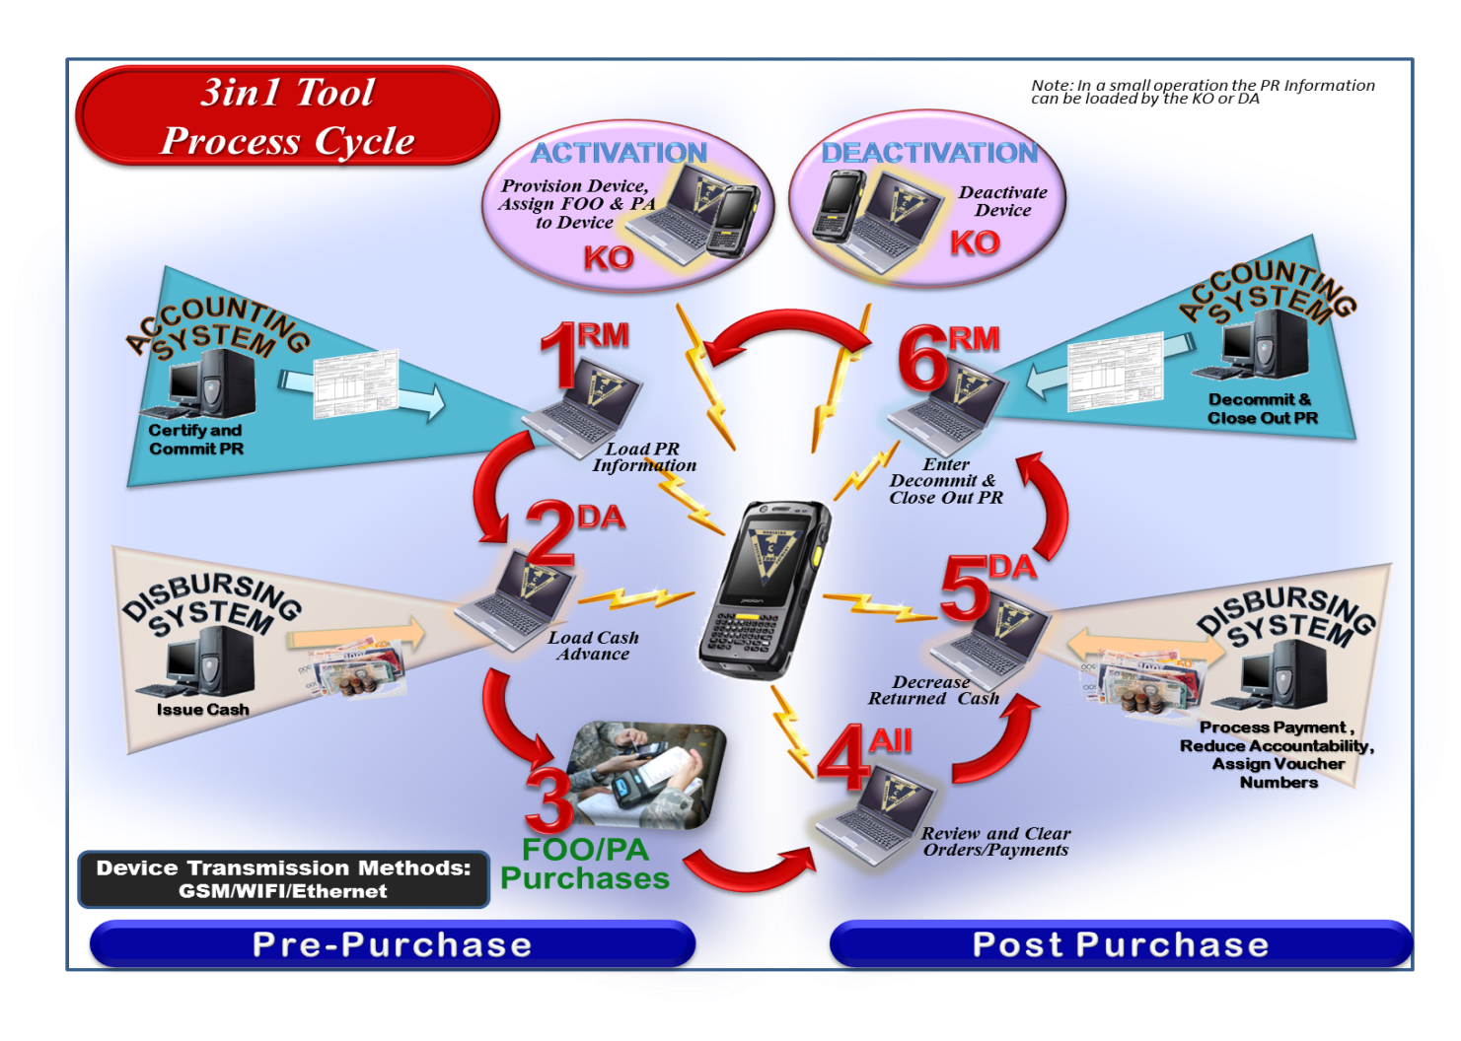
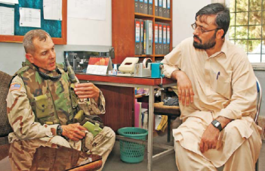

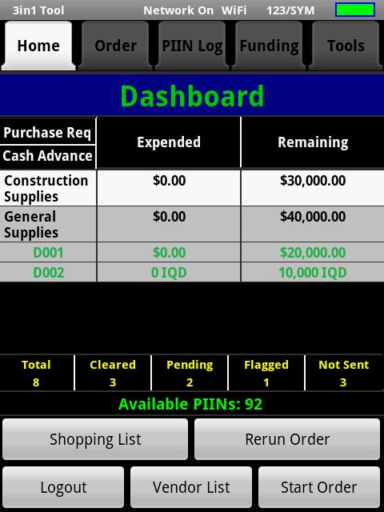
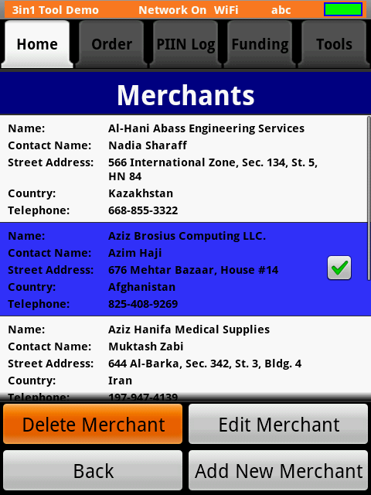
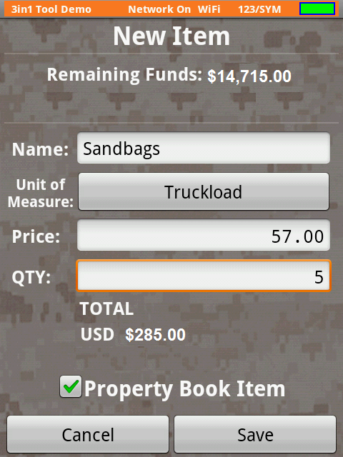
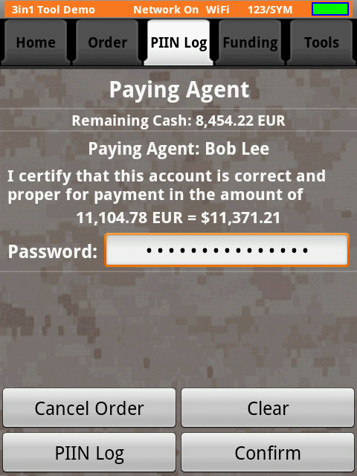
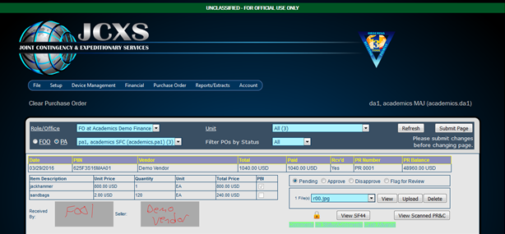
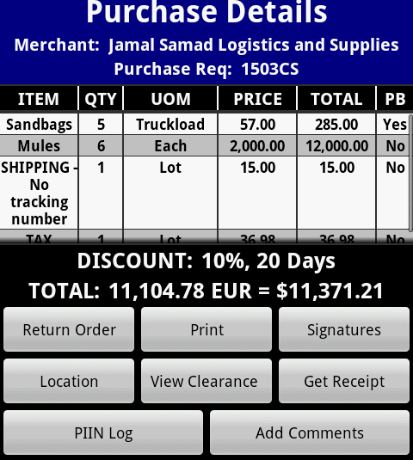
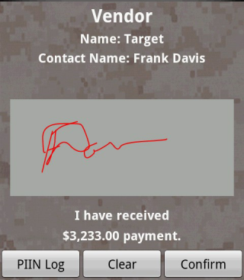
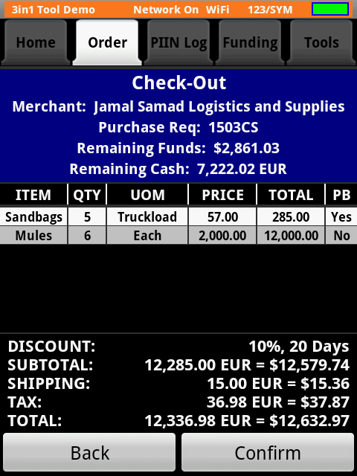
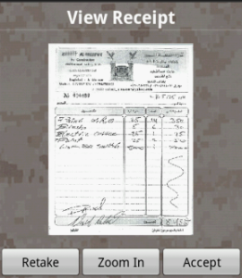
3IN1 TOOL WEBSITE: The 3in1 Tool website provides easy accessibility to perform all functions within the 3in1 Tool system. There are two ways to access the 3in1 Tool platform; this can be accomplished through CAC-enabled login or username/password.
AUTHENTICATION: Users register using DoD CAC cards to establish a user ID and strong password and to obtain approval for role based access. Secure digital Signatures are used to execute order and payment transactions. As each step of the purchase is completed, the information is locked and all data and images are transmitted to 3in1.
RECEIPT AND RECORD OF PAYMENT: Vendor receipts are digitally recorded with the onboard camera. Government receipt of goods and vendor payment are recorded as a digital image of the physical signature on the device’s touch screen.
CONTROLS: Procurement controls prohibit purchases in excess of authorized limits or check items against unauthorized lists and display warning messages.
ONLINE REVIEW: When connected, SF44 information is immediately available for review and clearance. Reviewers may view all information on the SF44 to include any required approval memos from a commander, C6, JA, etc that are attached to that order in 3in1. Reviewers can approve, disapprove, or flag an order and transmit a comment to the field team for response on the device.
TRANSMISSION TO BUSINESS SYSTEMS: Disbursing Agent (DA) transfers the cleared orders electronically to DDS for payment processing and to reduce the PA’s cash accountability. The PA will only need to return to the DA to obtain/return cash. Once completed, the SF44 and receipt is electronically transmitted and stored in EDA.
Features
All SF44 data captured/recorded/transmitted to 3in1
Records PR #, Amt, LOA -- ability to track multiple PRs
Records Cash Disbursement Amt and Exchange Rate
Digitally records receipt image and link to order
Calculates order total & currency exchange
Tracks obligations & available funds
Online role-based review process (PBO,KO,DA,RM)
  Information available daily without face-to-face clearing when cash exchange is not required
Access prices on device for market research
May record vendor location by GPS coordinates
Ability to attach notes to orders & Scans Barcodes
Upload supporting documents for retention in order’s electronic file--Approvals, Reviews, Hand Receipts
Management reporting capabilities on 3in1 Module
  Track Expenditures, Purchases, Cash in the field, Obligations, Available funds
  Pre-populate forms: hand receipts for property book
Push PR & procurement updates to device remotely
Track expenditures by disbursement/accounting line
Transmit SF44/receipt to EDA for document retention
Transfer payment data directly to financial systems
Create shopping lists to minimize time in the market
Reports for use by the FOO, FOO Managers, PA, KO, DA, and other Reviewers available on 3in1

